Slide 1
ECTOPIA
LENTIS
BY
ADREA R. BENKOFF M.D.

Slide 2
Case Presentation
CC/HPI: 19 yo female presents with decreased VA in both eyes over the past year. Subsequently complaining that she is unable to drive. Denies head or facial trauma, diplopia, flashes, floaters, blindspots, or pain.
POH: high/pathologic myopia, right esotropia (poor vision from young age OU)
*current glasses: -7.50 sph OD, -9.75 sph OS
Social Hx: Lives with family, one of 7 children. Currently in college, doing well academically, but socially limited due to poor vision.
Meds: None Allergies: NKDA
Notes:
Lens subluxed inferonasally OU, high myopia is more than -6 D, or an axial length greater than 26.5mm. Pathologic myopia is more than -8D or axial length greater than 32.5mm

Slide 3
Exam
SLE:
Tear film: wnl OU
Lids/adnexa: wnl OU, no ptosis
Conjunctiva/Sclera: white & quiet OU
Cornea: clear OU
Anterior Chamber: deep and quiet OU
Iris: round, no NV OU
Lens: inferonasal subluxation OU
Capsule: clear OU
Distance VA: cc 20/200 →PH NI (squinting) 20/80 → PH 20/50⁻²
Cycloplegic Refract: -11.50 sph 20/100
-11.75 sph 20/60⁻²
EOM: Full OU
Muscle Balance:
(6 meters) Right esotropia 10 diopters cc
Pupils: ERRL, no APD OU
CVF: full to count fingers OU
T_{A}: 15 OU
Notes:
Legal driving: 20/50 in one eye for daytime restricted. Better than 20/50 in one eye for unrestricted. At (distance) esotropia of 10 diopters (of prism to correct it) → possibly minimal amblypia of the R eye. Lens subluxation inferonasally OU.

Slide 4
Exam
DFE: 1% Mydriacyl, 1% cyclogyl
Vitreous: clear OU
Cup/Disc: .2 OU, sharp and pink OU
Blood Vessels: normal caliber OU
Macula: flat, wnl OU
Periphery: flat, no hemorrhages, breaks, tears, or detachments OU
Notes:
CYCLOGYL® 1% ophthalmic solution is an anticholinergic preparation that blocks the response of the sphincter muscle of the iris and the accommodative muscle of the ciliary body to cholinergic stimulation, producing pupillary dilation (mydriasis) and paralysis of accommodation (cycloplegia).
No w/u because father with known Marfan’s and marfanoid body type, arachnodactyly and subluxed lens.

Slide 5
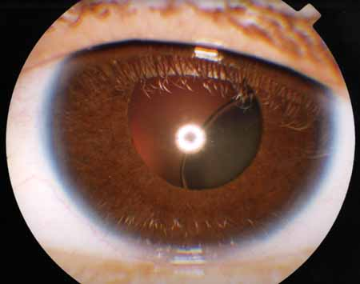
Notes:
Inferonasally dislocated lens OU, this is OD

Slide 6
Differential Diagnosis
Simple ectopia lentis
Ectopia lentis et pupillae
Marfan’s Syndrome
Homocystinuria
Weill-Marchesani Syndrome
Hyperlysinemia
Sulfite oxidase deficiency
Traumatic lens subluxation
Pseudoexfoliative disease
Other: aniridia, Ehlers-Danlos Syndrome, congenital syphilis, chronic uveitis

Slide 7
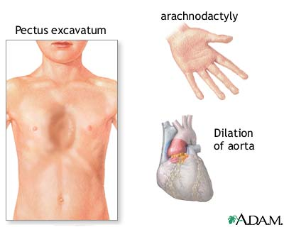
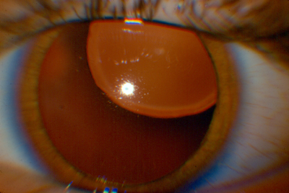
Diagnosis
Marfan’s Syndrome
Ectopia lentis
Notes:
Skeletal, CV, ocular systems key involved

Slide 8
Past Medical and Family History
50
20/30+
20/30+
*aortic insufficiency
23
20/40
20/40
*scoliosis
19
20/100 20/60-2
17
20/40-
20/30+
16
20/70
20/50+
13
20/50+
20/50-2
Marfan’s Syndrome
Notes:
Pt without systemic complications, has marfanoid habitus, arachnodactyly, and joint laxity only. No CV or skeletal complications. Father with AI and some aortic wall thinning, not warranting surgery. Possibly other children not affected due to variable penetrance/expression

Slide 9
Marfan’s Syndrome: Background
1896: Antoine Marfan (French Physician) put together the skeletal manifestations of the disease
Classic triad: subluxed lenses, skeletal anomalies, and cardiovascular disease
point mutation in chromosome 15q, band 21→ abnormal fibrillin
Autosomal Dominant, prevalence 4-6 per 100,000
  High penetrance
  15% sporadic
Notes:
AKA: dystrophia mesodermalis congenita-typus Marfanus, arachnodactyly. Triad: more far-reaching and effects lungs, muscles, genitourinary system, and skins as well as nearly every structure of the eye
Dr. Marfan (observation of pts), clinical study in 1896 described features of a 5yo girl, thin, long limbs, long fingers and toes.
Ophthalmologist saw iris tremor in two sibs with long limbs and hyperflexible joints

Slide 10
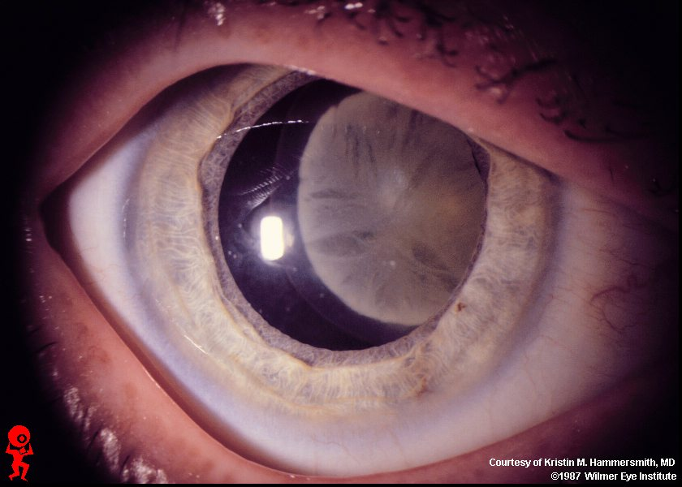
Epidemiology
Most frequent cause of inherited lens dislocation!
Affects both sexes equally
Found in all races

Slide 11
Ocular Features
Ectopia lentis: subluxated/luxated lenses
  Superior or superotemporal lens displacement, bilateral and symmetric
    Zonules appear intact, but stretched/elongated or focally attenuated, broken or absent
  50-80% of patients exhibit this finding
  Minority of pts with ectopia lentis → glaucoma
Signs: progressive myopia or noncorneal astigmatism, phacodonesis, iridodonesis, asymmetry of AC depth between two eyes, positional variation in IOP
Notes:
Luxated: when completely outside the lens patellar fossa into the ant chamber, vitreous or on the retina. Posterior: zonular and Wieger’s vitreal ligament attachments to lens capsule completely severed, anterior: few attachments may still be present (esp. if small lens).
Small lens can easily pop back and forth with pupil dilation
Dislocation into AC or pupil can cause pupillary block, blocks flow of aq from post to ant chamber→ iris bows and angle-closure glaucoma
Partial dislocation/subluxed: still within lens space/pupillary area, some zonular fibers and/or Wieger’s vitreal ligament are attached
Signs: progressive myopia or noncorneal astigmatism (from anterior displacement or tilting of lens)
Phacodonesis (tremulous lens resulting from some/most of zonular fibers broken) (seen when pt rapidly centers gaze from an eccentric position)
gonioscopy: iridodonesis (tremulousness o iris with eye movement as a signs of subluxation) in areas of zonular deficiency
asymmetry of the depth of the AC between two eyes or marked variations in depth from one quadrant to another in an affected eye,
pupillary block from ectopia lentis imparts a “volcano crater” contour to the central iris, may see a small bead of vitreous pushing through the pupil.
tonometry in various eye positions may reveal significant diffs due to position-dependent pupillary block

Slide 12
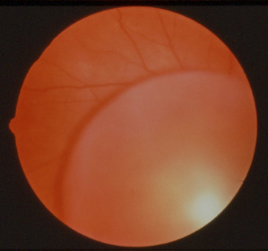
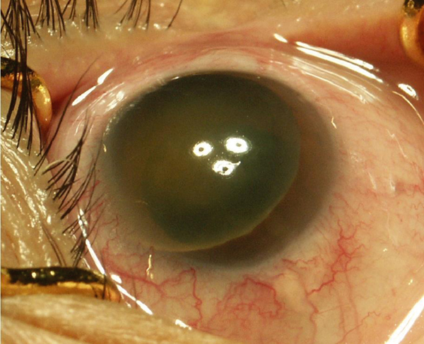
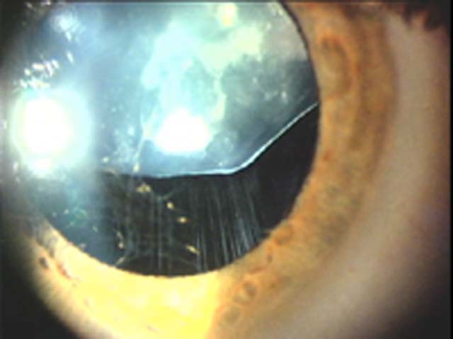
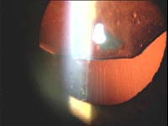
Notes:
Posterior dislocated lens on retina, anterior dislocated lens causing pupillary block and acute angle closure, see stretched zonules. Lens: normal or small lens with flatter curvature of lower half and posterior buldge (due to weakness or absence of inferior zonules reducing capsule traction)

Slide 13
Other Ocular Features
High axial myopia
High risk of lattice degeneration
  Atrophic disease of the peripheral retina (thinning, pigmentary changes)
Retinal detachment
Microphakia
Strabismus
Ptosis
Megalocornea, flat corneas
Premature cataracts (30-50yo)
Hypoplasia of iris stroma and dilator muscle→ can have peripheral transillumination, and poor dilation with mydriatic drops
Early vitreous syneresis
Uveal colobomas
Notes:
High risk of lattice degeneration: Lattice degeneration is a common, atrophic disease of the peripheral retina characterized by oval or linear patches of retinal thinning. The prevalence peaks by the second decade and is believed to be minimally progressive but may be uncommonly complicated by retinal detachment in approx 5-11% of pts.), sometimes with staphylomata (protrusion of the sclera or cornea, usually lined with uveal tissue, due to inflammation), thin, bluish sclera, and large corneas (w greater radius of curvature), uveal colobomas (This coloboma can present as an iris coloboma (A hole is present from birth and can be caused when a gap called the choroid fissure between two structures in the eye, which is present early in development in the uterus, fails to close up completely before a child is born. the iris is the colored part of the eye), with the traditional "keyhole" or "cat-eye" appearance to the iris, and/or as a chorio-retinal coloboma where the retina in the lower inside corner of the eye is missing.), also get vitreous liquefication at an early age (vitreous is a CT), and peripheral fundus pigmentary changes. Can also have ptosis and commonly strabismus. Hypoplasia of iris dilator muscle causes pupil to remain small even in response to mydriatic drops. Corneas are flat, mean corneal astigmatism measures more than 2 diopters (normal US population is .6-.8), therefore keratometry is helpful prior to refraction.

Slide 14
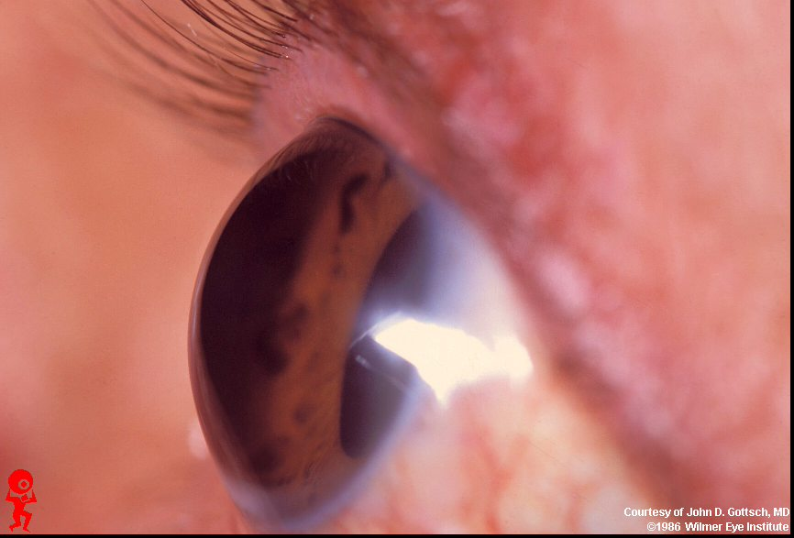
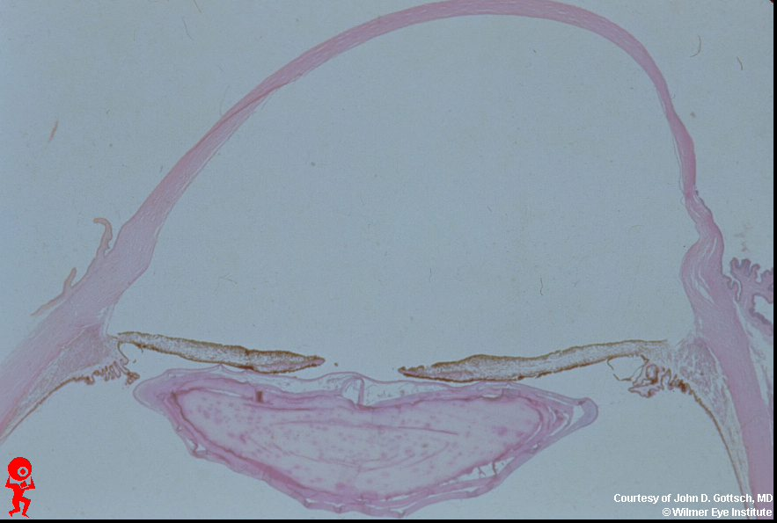
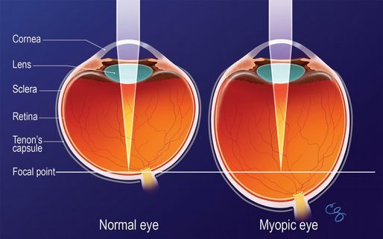
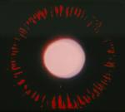

Notes:
Megalocornea, axial myopia (mean axial length approx 28.47mm), iris transillumination defects (hypopigmentation of iris pigment epithelium), strabismus due to deficient fibrillin in extraocular muscle pulleys that cause their instability.

Slide 15
Systemic Features
Marfanoid habitus
Arachnodactyly
Muscular hypoplasia & hypotonia→ joint laxity
Pectus excavatum
Scoliosis
Aortic dilation→ dissecting aneurysm
Valve disease: MVP, AI
Decreased subcutaneous fat
Lungs: cystic malformation, lobulation, emphysema
Genitourinary system: ureteric strictures→recurrent pyelonephritis
Notes:
Marfanoid habitus (tall and thin, w disproportionate growth of extremities, esp lower), arachnodactyly (hands with disproportionately long and thin fingers), general muscular hypoplasia and hypotony lead to joint laxity with occasional contracture (permanent shortening of muscle or tendon), pectus excavatum (congenital deformity of the anterior wall of the chest, in which several ribs and the sternum grow abnormally. This produces a caved-in or sunken appearance of the chest.), scoliosis, and increasing dilation of the ascending aorta w aortic insufficiency, can have MVP. Death freq from dissecting aortic aneurysm. Lungs can have abnormal lobulation, cystic malformations, aplasia of parts of the lungs, progressive emphysema, and occasionally fibrosis of unknown etiology occurs. Genitourinary system small mobile kidneys can have ureteric strictures which predispose to recurrent pyelnephritis. Can have epidermal striae and lack of subcutaneous fat in almost all pts.
Cardiovascular anomalies in >1/3 pts. Aortic valve and ascending aorta undergo degenerative process of the tunica media leading to formation of dissecting aneurysm
Sometimes pts lack systemic findings and present only with eye findings
tall stature, joint hypermobility, aortic wall defects, mitral valve prolapse. Minor= long, narrow face (dolichocephaly), ptosis of eyes, long nose, high and narrow palate, madibular retrognathia, spontaneous pneumothorax, lumbosacral dural ectasia (widening or ballooning of the dural sac surrounding the spinal cord).

Slide 16
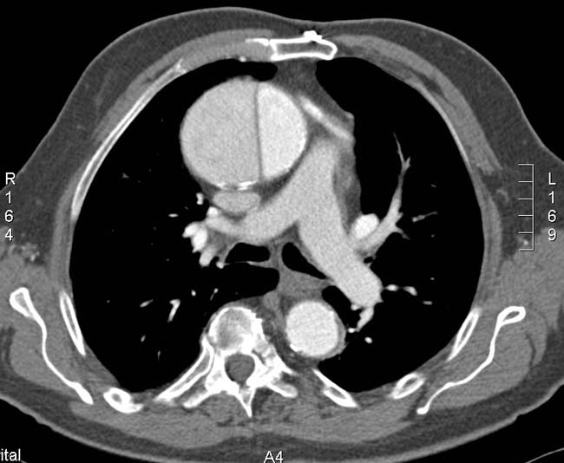
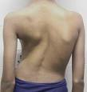

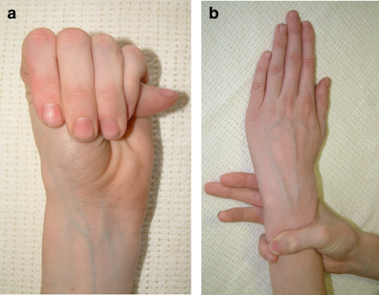
Notes:
Aortic dissection, joint laxity and arachnodactyly (long thin fingers), pectus excavatum, scoliosis, marfanoid habitus.

Slide 17
Diagnosis
Genetic testing: (fibrillin-1) FBN1 gene mutation on chromosome 15
  Limited use due to locus heterogeneity, large size of gene, and sporadic cases
Clinical diagnosis: depends on major and minor signs as defined by Ghent nosology (1996)
  Unequivocally diagnoses or exclude Marfan in 86% of cases
Notes:
Ghent: Major criteria present in 2 organ systems (skeletal, ocular, CV) plus a 3rd organ system involved.
SKELETALMajor (Presence of at least 4 of the following manifestations)•Pectuscarinatum•Pectusexcavatumrequiring surgery•Reduced upper to lower segment ratio ORarm span to height ratio >1.05•Wrist and thumb signs •Scoliosis of >20°or spondylolisthesis•Reduced extension at the elbows (<170°)•Medial displacement of the medial malleoluscausing pesplanus•Protrusioacetabulaeof any degree (ascertained on radiographs)Minor•Pectusexcavatumof moderate severity•Joint hypermobility•High arched palate with crowding of teeth•Facial appearance 􀂾Dolichocephaly, malarhypoplasia, enophthalmos, retrognathia, down-slanting palpebralfissures
OCULARMajor•EctopialentisMinor (at least 2)•Flat cornea•Increased axial length of the globe•Hypoplasticiris OR hypoplasticciliarymuscle causing decreased miosis
CARDIOVASCULARMajor•Dilatation of the ascending aorta with or without ARand involving at least the sinuses of Valsalva•Dissection of the ascending aortaMinor•Mitralvalve prolapse with or without MR•Dilatation of the main PA, in the absence of valvularor peripheral PS below the age of 40 years•Mitralannular calcification below the age of 40 years•Dilatation or dissection of the descending thoracic or abdominalaorta below age of 50 years.

Slide 18
Pathology
Ectopia Lentis:
Abnormal production, distribution, and attachment of zonules
  Chief component of zonules is fibrillin
  Zonular bundles are thin and scanty
Notes:
immature ciliary body w hypoplasia of the muscular elements. The ciliary body lies just behind the iris. Attached to the ciliary body are tiny fiber "guy wires" called zonules . One function of the ciliary body is the production of aqueous humor, the clear fluid that fills the front of the eye. It also controls accommodation by changing the shape of the crystalline lens. When the ciliary body contracts, the zonules relax. This allows the lens to thicken (miosis moves lens ant), increasing the eye's ability to focus up close. When looking at a distant object, the ciliary body relaxes, causing the zonules to contract (mydriasis move lens post). The lens becomes thinner, adjusting the eye's focus for distance vision.
Zonules:
composed of highly oriented 10nm fibrils (microperiod of 10-12nm, macroperiod 45-55nm), aggregated into fibers and bundles (look like beads held together by multiple filaments)
capable of stretching
zonular fibers are made up of cysteine-rich glycoprotein, chief component fibrillin

Slide 19
Pathology
Secondary glaucoma:
Lens dislocation into pupil or AC→ pupillary block→ iris bowing→angle closure glaucoma
Open angle: can present in childhood or adolescence
  Congenital anomalies of the AC angle
    Dense iris processes, incompletely developed angle
    Concave iris tissue
    Abnormal insertion of ciliary musculature into trabecular meshwork (chronic)
Notes:
Open angle glaucoma may also develop freq in childhood or adolescence. Assoc with congenital abnormalities of the AC angle, dense iris processes bridge the angle recess, inserting anterior to the scleral spur. This iris tissue may have concave configuration. Can also have chronic form of glaucoma relating to an abnormal insertion of the ciliary musculature into the trabecular meshwork. Can have glaucoma with incompletely developed angle with prominent iris processes (mesodermanl remnants).

Slide 20
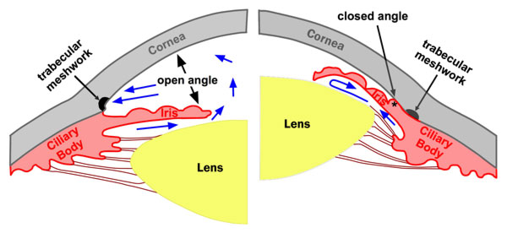
Notes:
Closed angle glaucoma developed from pupilary block after ant subluxation of the lens. Blocks trabecular meshwork and drainage of aq flow.

Slide 21
Pathology
Retinal detachments:
Combination of axial myopia, vitreous syneresis and abnormal vitreoretinal adhesions → rhegmatogenous RD
Subluxated/luxated lens capsule exerts traction on vitreous base→ peripheral tears

Slide 22
Management
Ectopia lentis:
Refractive aids: glasses, contact lenses, need reading add if subluxed lens
Pharmacological pupil manipulation
Surgical lens extraction: cataract formation, anisometropia or refractive error not otherwise correctable, impending dislocation, lens-induced glaucoma or uveitis
  Marfan pts have high rate of surgical complications
Notes:
Miotic pilocarpine. Can have lensectomy with PPV to prevent future RD
In young patients post dislocation is usually benign bc a young lens is inert and will fall to the bottom of the eye, can then correct with glasses/CL. Can cause complications more when it is a mature cataract and leaks cortex, then needs to be removed.
If lens dislocates completely and is out of optical axis (pupil), then put on + contact lenses to replace the approx +12 diopter power of the lens.
If no glaucoma and small lens then miotics can prevent subluxation anteriorly.
Surgical complications (bc weakened zonules and long axial length) less with more modern techniques but include: vitreous loss and complex RD, and vitreous incarceration in the wound, iris prolapse, corneal edema, postop hyphema, and persistent postop iritis.
Posterior dislocation: may cause vitreous traction and leakage of lens proteins into vitreous→chronic vitreitis and chorioretinal inflammation

Slide 23
Surgical Management
Lens extraction:
phacoemulsification with PCIOL implantation
  Cionni ring (modified capsular tension ring)
    MCTR has a hook allowing for scleral fixation without violation of capsular bag
    Less likely to have vitreous loss operatively, can perform through 3.0mm incision → rapid visual recovery
  Can achieve 20/40 or better post-op with Cionni ring
    Most common complication is PCO requiring YAG posterior capsulotomy
Notes:
Cionni ring for pts with generalized zonular degeneration (up to 180⁰ zonular dehiscence). Not enough zonular support to use CTR (up to 90⁰ zonular dehiscence).
Ring remains centered after YAG. Can see post capsule tear and vitreous in ant chamber during surgery. Variations on when implant Cionni ring, do it before lens is out for better support during phaco or do it after lens is out for easier insertion but more technically difficult surgery. Before Cionni surgeons sometimes put sutures in CTR but this disrupted the capsular bag.

Slide 24
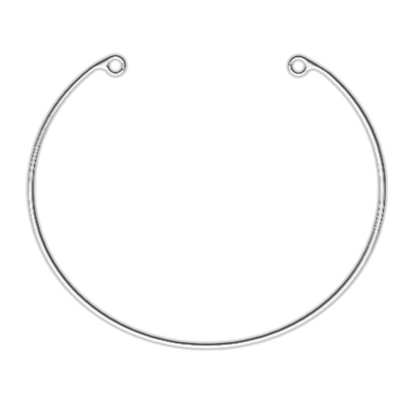
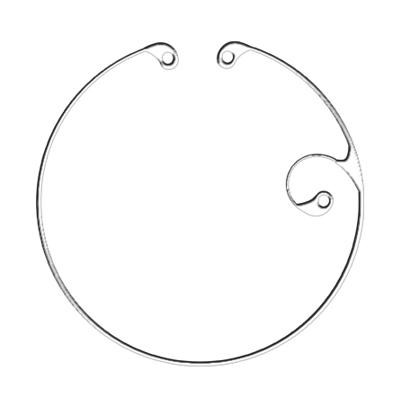
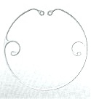
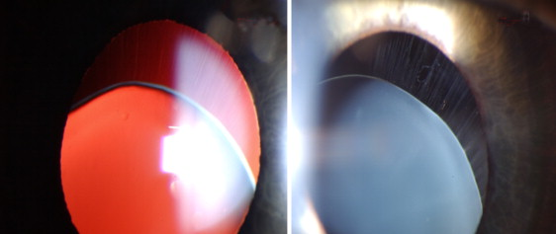
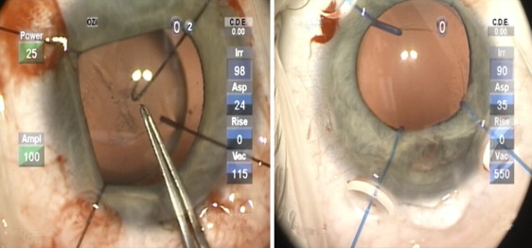
Notes:
Capsular tension ring, modified CTR (Cionni ring), see hooks for scleral fixation.
The lens is stabilized by introducing disposable iris retractor through 1mm incision at the center of the dialysis, engaging the capsulorhexis edge.
The MCTR is placed through the main incision and in the capsular bag with a dull tying forceps

Slide 25
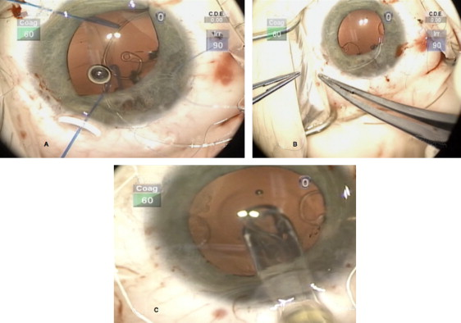
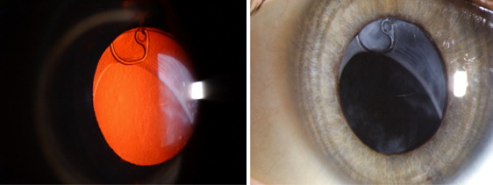
Notes:
3. A scleral flap is created, and Two needles pass through main incision and out through the cilliary sulcus and scleral wall, exit beneath the scleral flap 2mm post to the limbus and 2mm apart from each other
4. To center and stabilize the capsular bag the sutures are tightened and tied.
5. After capsular bag is reinflated with Provisc, the PCIOL is placed in bag and optic is well centered and posterior to elbow of the cionni ring fixation hook
6. After the conjunctiva is reapproximated over the scleral flap, the incisions are hydrated, scleral pressure is applied at the posterior lip to ensure the incisions are stable.

Slide 26
Management
Glaucoma:
Anterior lens dislocation: pupillary block with acute or chronic angle closure glaucoma
Goniotomy or trabeculotomy for children
Older kids and adults: medical management of IOP with mydriatics, and supine positioning
Peripheral laser iridotomy
Surgery: iridectomy, lens extraction if in AC, tube shunt placement
Notes:
Freq episodes of pupillary block causing angle closure glaucoma bc lens is small and comes forward to occlude pupil (relief of block by mydriatics (cycloplegic agent pulls lens posteriorly by relaxing ciliary body and contracting zonules makes lens thinner, but requires residual zonular function to work, scopolamine .25% tid, or atropine 1% bid) or laser iridotomy, and worsening by miotics (lens moves anteriorly)→ term “inverse juvenile glaucoma).
goniotomy (An opening is made in the trabecular meshwork, the group of tiny canals located in the drainage angle, where fluid leaves the eye. The new opening provides a way for fluid to flow out of the eye. Goniotomy is a surgery for children only. Maybe put in drain) or trabeculotomy (Surgical opening of the canal of Schlemm to treat glaucoma. Kids only) in infancy, older kids should be medically managed first.
PI is for angle closure, creates opening btwn post and ant chamber for drainage, may need more than one laser iridotomy to find place where vitreous is not adherent to posterior iris, it is less likely to become blocked if over an area of intact zonules
surgical iridectomy (surgical removal of part of the iris)

Slide 27
General Management
Approximately 50% of patient’s with Marfan’s Syndrome are diagnosed by an ophthalmologist!
    Myopia is not adequately corrected by lenses
    Non-traumatic lens dislocation
Slit-lamp exam, dilated fundus exam for every evaluation
  Annual exam is recommended until age 12 to prevent amblyopia
  If family Hx then initial exam at 3-6 months of age
Must work up the patient and refer for full medical (internist, cardiologist) and orthopedic evaluation (including immediate family)
Notes:
Adults can be seen annually or biannually
Most common inherited cause of lens dislocation/subluxation
Marfans pts often die from CV complications (aortic aneurysm/dissection), therefore must be worked up and followed closely

Slide 28
Prognosis
Ectopia Lentis:
Depends on degree of lens subluxation and location
  Secondary complications of lens subluxation/luxation as discussed
When lens completely dislocates, if posterior without complications then good prognosis
  Good VA with glasses or contact lenses
Notes:
Ant→CAG, post w cataract leakage→uveitis/vitreitis, chronic inflamm
If lens dislocates completely and is out of optical axis (pupil), then put on + contact lenses to replace the approx +12 diopter power of the lens.

Slide 29
Familial lens subluxation/luxation
50
Inferior and inferonasal dislocation in vitreous
19
Inferonasally
OU
13
Superonasal subluxation OU
23
Inferotemporal OD
Temporal OS
17
16
Superonasal OD inferotemporal OS
Nasal OD
Inferotemporal OS
Notes:
Pts do not always read textbooks!
Pt was inf nasal
Father dislocated

Slide 30
Case Presentation
Plan:
Refer for surgical consultation OS
  Lensectomy with Cionni ring technique
New refractive prescription for progressive myopia
Follow up in 1 year
Notes:
OS is better eye so better potential for improved vision (RET so presumed OD is amblyopic)

Slide 31
Traumatic Lens Dislocation
Most common cause of acquired lens displacement
  Accounts for 22-50% of lens subluxations
Associated with cataracts and rhegmatogenous retinal detachment
Zonules rupture presumably at lens attachments secondary to mechanical stretching
  Eye is compressed in ant-post direction (i.e. fist) and the distention of the globe in the medial-lateral plane ruptures the zonular fibers

Slide 32
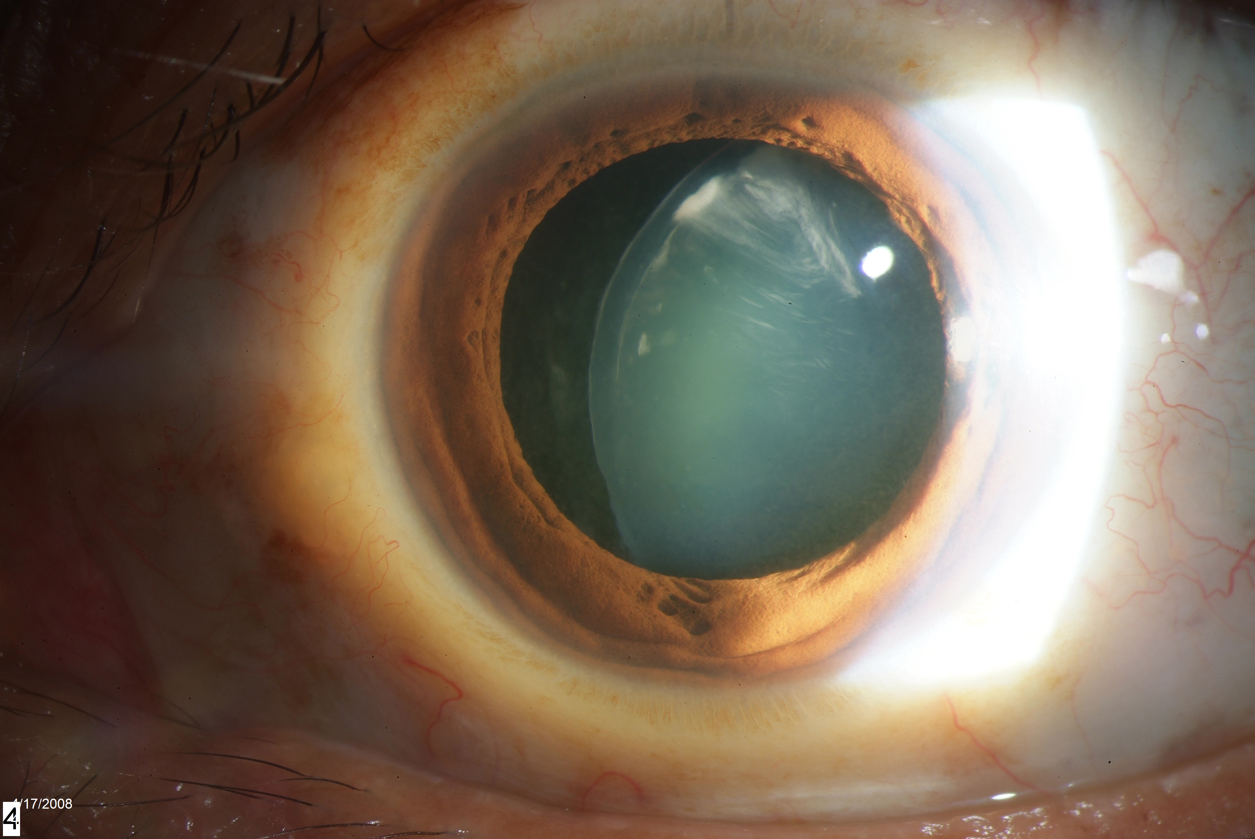
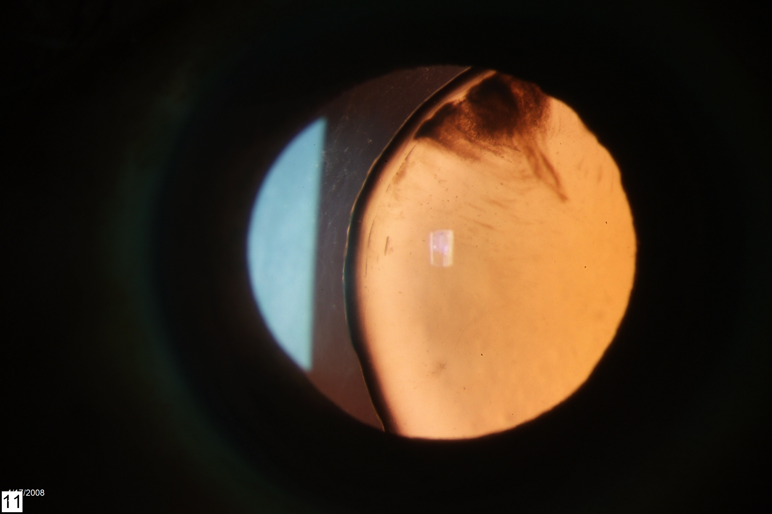
Notes:
Traumatic cataract

Slide 33
Homocystinuria
2nd most common cause of inherited lens dislocation
AR, prevalence 1:200,000
Virtual absence of cystathionine b-synthetase
Dx: increased serum homocystine, methionine, homocysteine
Ocular abnormalities: ectopia lentis, RD
  Lens displacement: bilateral and symmetric, usually inferonasal
Systemic features: fair skin, malar flush, pale coarse hair, poor peripheral circulation, 50% mental retardation, marfanoid habitus, osteoporosis, seizures
Increase thromboembolic events, especially with anesthesia
Notes:
1:60,000 in Ireland
virtual absence of cystathionin Beta-synthetase (enzyme catalyzes conversion of homocysteine to cystathionine)
two forms: one is responsive to pyridoxine (vit B6), precursor of coenzyme for cystathionine beta synthetase
Responsive type: decreased binding to coenzyme
level of methionine, homocystine, and homocysteine are elevated in serum, with increase urinary excretion
progressive zonular degeneration results in lens dislocation in about 90% of pts. ectopia lentis (90% pts by third decade, not congenital), RD. Dislocation: 30% in infancy, 80% by 15yo.
Anterior subluxation/dislocation can lead to pupillary-block glaucoma. Tx: dilation of pupil, peripheral irdectomy, and lens extraction if in AC.
Findings (healthy at birth but develop): fair skin, lightly pigmented (blond hair, blue eyes), malar flush, pale coarse hair, poor peripheral circulation, 50% incidence of MR, often marfanoid habitus (arachnodactyly, pectus abnl), osteoporosis, seizures, increased incidence of thromboembolic events (a and V) esp with anesthesia

Slide 34
Homocystinuria
Pathology: abnormal zonular development due to cysteine deficiency
  Zonular fibers are made up of cysteine-rich glycoprotein
  Affected zonules are brittle and easily disrupted, with short disoriented fibrils
Exam findings: spherophakic, scalloped lens border, lens dislocation into AC→glaucoma
Treatment: low methionine, high cysteine diet and vitamin supplementation with coenzyme pyridoxine→decreased incidence of ectopia lentis
Prognosis: favorable if treatment is started soon after birth
Notes:
deficiency of cystathionine Beta-synthetase may decrease availability of cysteine for incorporation into the high cysteine-containing zonular fibers→reduced sulfhydryl cross-links and fragmentation (implies that zonular integrity necessitates continual renewal).
Defic of cysteine disturbs normal zonular development (affected fibers tend to be brittle and easily disrupted)
Progressive dz, zonules rupture in midstream, forming “fringe” of broken fibers around lens
Lens: spherophakic, crenated (scalloped) border, dislocate into the anterior chamber, occlude pupil and cause glaucoma
Elongated globe, RD frequent (esp after len surgery)
Histopathology: Zonular fibers are fragmented into thin short lengths, increasingly intermingled with osmiophilic dense granules (may represent a breakdown product that cannot be further metabolized). Zonular bundles show abnl porous sponge-like appearance, due to short, disoriented fibrils composing them. Ciliary nonpigement epith shows progressive degenerative vacuoles and enfolding of epith surface. Also see progressive degeneration of peripheral retina and RPE

Slide 35
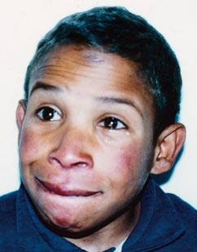
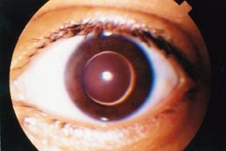
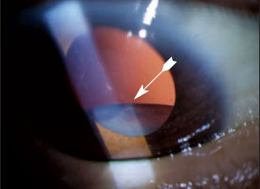
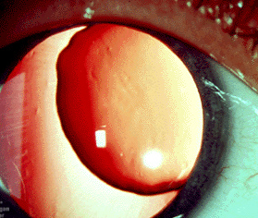
Notes:
Malar flush, spherophakic, crenated (scalloped) border, explain that photo is not typical direction of displacement but can see scalloping of edges

Slide 36
Weill-Marchesani Syndrome
3rd most common cause of inherited lens dislocation
AR, some heterozygote expression
Dx: molecular genetic test for ADAMTS10
Ocular abnormalities: ectopia lentis, microspherophakic lens, lenticular myopia, micro/megalocornea, cataracts, pupillary block
  Lens displacement: usually inferior but sometimes central
  Zonular bundles appear taut or lax and abnormally elongated
Systemic features: brachymorphism-short stature, short, broad hands and feet, limited joint mobility, well-developed muscular appearance, thick skin, brachycephaly
Notes:
(congenital mesodermal dysmorphodystrophy-brachymorphic type):
AR (some heterozygotes express, male = female affected), spherophakia-brachymorphism, findings reverse of Marfan’s syndrome (noted in 1932 by Weill, and 1939 by Marchesani), findings limited to skeletal system and eyes
Lens: small and spherophakic, up to 15-20 diopters of lenticular myopia (progressively occurring)
with tilting and eventual complete dislocation

Slide 37
Weill-Marchesani Syndrome
Frequent episodes of pupillary block causing angle closure glaucoma (microphakia)
Treatment:
  Lensectomy
  Glaucoma: mydriatics, laser iridotomy (can be prophylactic), iridectomy and miotics to prevent lens dislocation in AC
Prognosis: loss of vision is earlier and more severe than other lens dislocation syndromes
Notes:
Freq episodes of pupillary block causing angle closure glaucoma bc lens is small and comes forward to occlude pupil (relief of block by mydriatics (cycloplegic agent pulls lens posteriorly but requires residual zonular function to work, scopolamine .25% tid, or atropine 1% bid) or laser iridotomy, and worsening by miotics (lens moves anteriorly)→ term “inverse juvenile glaucoma). May develop peripheral anterior synechias
Glaucoma usually in early adulthood or late childhood.
Can also be from inferior dislocation of the lens causing increased pressure by either irritation of the ciliary body with overproduction of aqueous or mechanical anterior displacement of the inferior iris with subsequent angle closure in that area. Also hypoplasia of the ciliary body can cause crowding of the angle.
iridectomy eliminates the problem of miotics exacerbating CAG and allows safe use of miotics to prevent dislocation of lens into AC

Slide 38

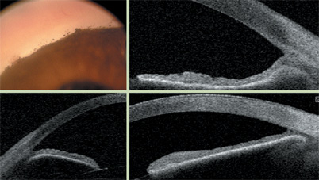
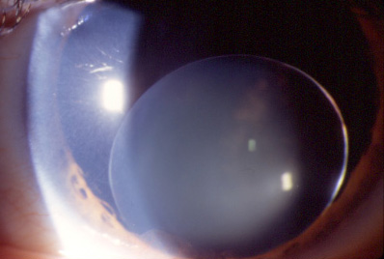

Notes:
brachycephaly (flat head), broad short hands, ectopia lentis (subluxed)
Peripheral anterior synechiae,can get with ant displacement of lens→pupillary block→ closed angle glaucoma (iris processes to trabecular meshwork)

Slide 39
Simple (isolated) ectopia lentis
Usually AD, most at birth with superotemporal lens displacement
  Some cases of delayed onset in 6th/7th decade with downward dislocation
Gene defect localized to fibrillin gene on chromosome 15
Ocular findings: microspherophakic
Deficiency of zonular fibers, poor aggregation of zonules still present, and some abnormally thick fibrils
No associated systemic features
Notes:
Usually AD, most are present at birth with upward and temporal displacement of lenses
Defect localized to region of fibrillin gene on chrom 15 (marfans gene)
Lenses are small and spherical (microphakic, spherophakic)
Some cases of delayed onset, sixth and seventh decade (downward dislocation)
Path: small spherical lenses with deficiency of zonular fivers, and poor aggregation of those present, may also have a few abnl thick fibrils

Slide 40
Ectopia Lentis et Pupillae
AR, pupils are oval or slit-like with >.5mm nasal and downward eccentricity
Ocular findings: lens is displaced in direction opposite of pupil displacement, usually bilateral and asymmetric
Often atrophic irides that dilate poorly and with marked transillumination defects
rapidly progressing cataracts, severe axial myopia, occasional RD
Developmental defect of neuroectodermal layer results in failure of iris pigment epithelial cells to develop normal dilator muscle, presumably associated with poor secretion of zonular fibrils
Notes:
(often asymmetric) pupils. Often develop cataracts (NS or C) that progress rapidly to maturity
Commonly have severe axial myopia (avg AP diam of 26mm, normal is approx 24mm)→ occasional RD

Slide 41
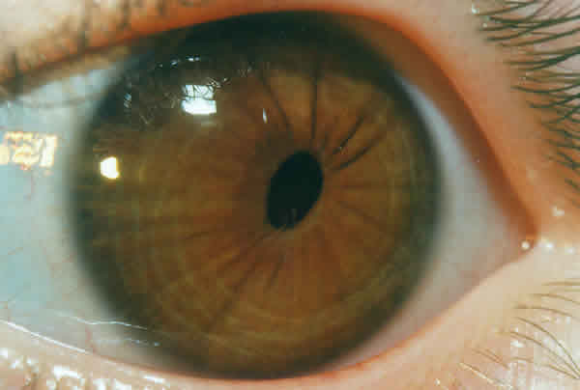
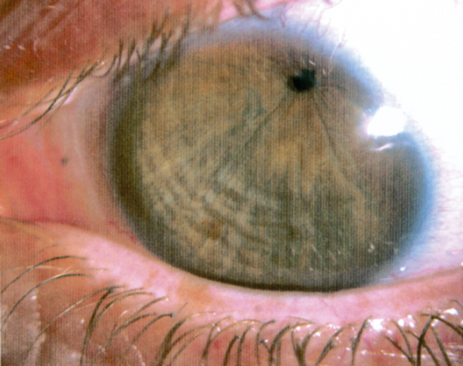
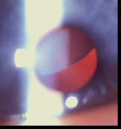
Notes:
Eccentric pupils, bottom L is subluxed, would be opp to pupil if same pt. see that pupil is inferotemporal and lens is superonasal

Slide 42
Sulfite Oxidase Deficiency
Rare AR, disease of sulfur metabolism
  Enzyme deficiency results in excess sulfite
Ocular features: dislocated lens (nonspecific)
Systemic features: (in first year of life)
  Poor feeding, severe neurologic abnormalities, seizures, myoclonus, and severe mental retardation
Excess sulfite can destroy disulfide bonds, may cause lens dislocation since disulfide linkages are important for intramolecular bonds in fibrillin
Generally poor prognosis for neurologic abnormalities
Notes:
Rare AR, dz of sulfur metabolism
Sx in first year of life: poor feeding, severe neurologic abnl, sz, myoclonus, severe MR.
Dislocated lens: noted after delays of several mos to 4yrs (no specifics)
Enzyme defic results from defect in molybdenum cofactor, sulfite oxidase is necessary for final degradation of sulfur containing amino acids (oxidizes sulfite to sulfate)
Excess sulfite can destroy disulfide bonds and react with free sulfhydryl groups. Toxic effect may cause lens dislocation since disulfide linkages are important for intramolecular bonds in fibrillin
Patho: hypoplasia of ciliary body, decrease in retinal ganglion cells, absence of myelin in optic nerve, and ectopia lentis not specifically described
Fibrillin is main component (composing zonules)

Slide 43
Hyperlysinemia
Rare AR, defect in amino acid lysine metabolism
Ocular findings: bilateral superior subluxation of lenses, strabismus, bilateral spherophakia
Systemic findings: mental retardation, muscle hypotonia, convulsions
Dx: increase plasma levels of lysine
Ocular lens pathology unknown
Tx: low protein diet may be helpful
Notes:
AR, rare defect in amino acid lysine metabolism
Bilateral superior subluxation of lenses, right lateral rectus m palsy, bilateral spherophakia (case reports of 7pts). Can have MR, muscle hypotonia, convulsions, and strabismus
Difficult to assess bc of consanguinity
Results from deficiency of lysine degradative enzyme, lysine-ketoglutarate reductase, ocular lens pathology unknown

Slide 44
Pseudoexfoliation
Spontaneous subluxation in 5% of patients
Signs: may see phacodonesis, iridodonesis may be absent due to relative immobility from pseudoexfoliative deposits in stroma and muscle
Zonules break midstream or at ciliary body
Zonules are infiltrated with pseudoexfoliative material and are fragile
Notes:
spontaneous subluxation in 5% of these pts (often occult until cataract extraction)
Signs: iridodonesis (tremulousness o iris with eye movement as a signs of subluxation) may be absent bc it’s relatively immobile from pseudoexfoliative deposits in stroma and muscle (papillary sphincter m) or bc posterior synechiae (adhesions) to the midzone of the lens. Can sometimes see phacodonesis (tremulous lens resulting from some/most of zonular fibers broken).
Zonules break in midstream or at ciliary body, zonules are infiltrated with pseudoexfoliative material and are fragile

Slide 45
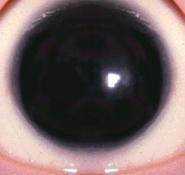
Other causes of ectopia lentis
Aniridia
Ehlers-Danlos Syndrome
Congenital syphilis
Chronic uveitis
Notes:
Aniridia: spontaneous dislocation due to defective formation of the anterior segment including the zonules
Ehlers-Danlos: CT disorder defect in collagen synthesis, faulty or reduced amounts of Type III collagen they tend to be hyperflexible/stretchy (zonules are CT of the eye, too flexible not good support)
Syphilis and chronic uveitis: weakened zonules secondary to chronic inflammation

