Slide 1
LASIK vs ASA
Case Studies
Alan C. Parent, M.D., F.A.C.S.

Slide 2
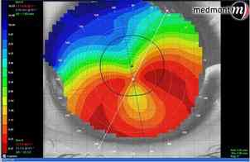
When I Recommend ASA
1. Pachymetry < 475
2. Residual bed < 275 microns
3. Post float/Ant float suspicious
4. Irregular topography
5. Corneal dystrophies

Slide 3
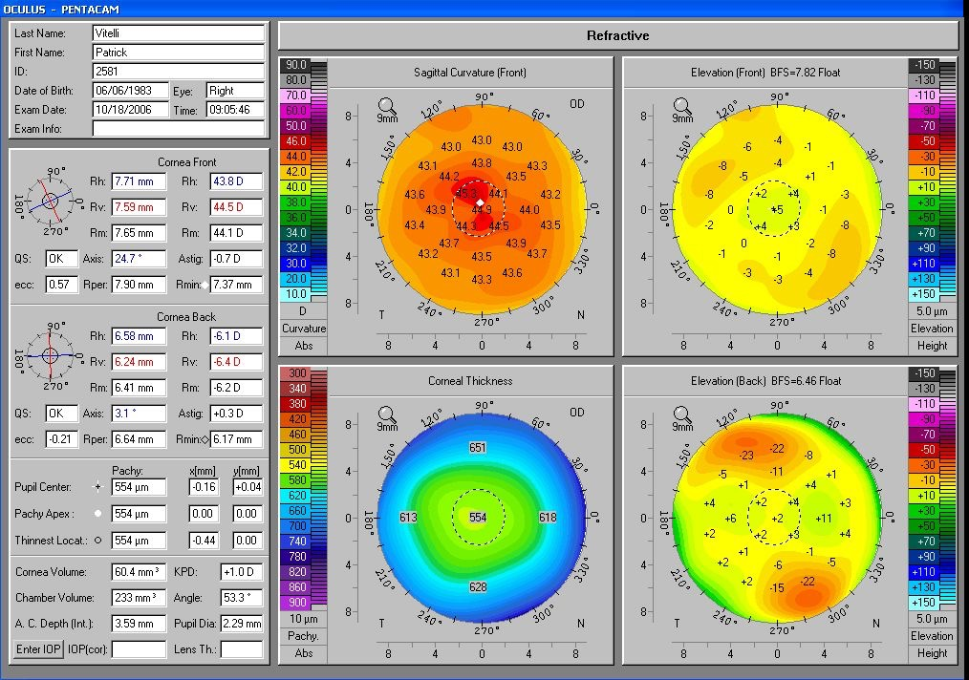
Elevation Map (normal)
K Readings
Anterior Elevation Map
Corneal Pachs
Posterior Elevation

Slide 4
Red Flags
Posterior “float” greater than +20 (central 5mm zone)
Anterior “bump” greater than +15 (central 5mm zone)
Inferior corneal steepening
Asymmetric astigmatism (Difference SI > then 1.5 diopters central 3mm)
Decentered corneal apex

Slide 5
Other things to consider
1. Patient’s risk tolerance
2. Presence of ocular surface disease
3. High Myopia
4. Recovery time
5. Pain tolerance

Slide 6
Case #1
33 yo female
OD -7.25-.75 x 165 20/20
OS –7.50-1.00x 30 20/20
Pachs 478 OD 477 OS
Normal health
Told “not a candidate for surgery”

Slide 7
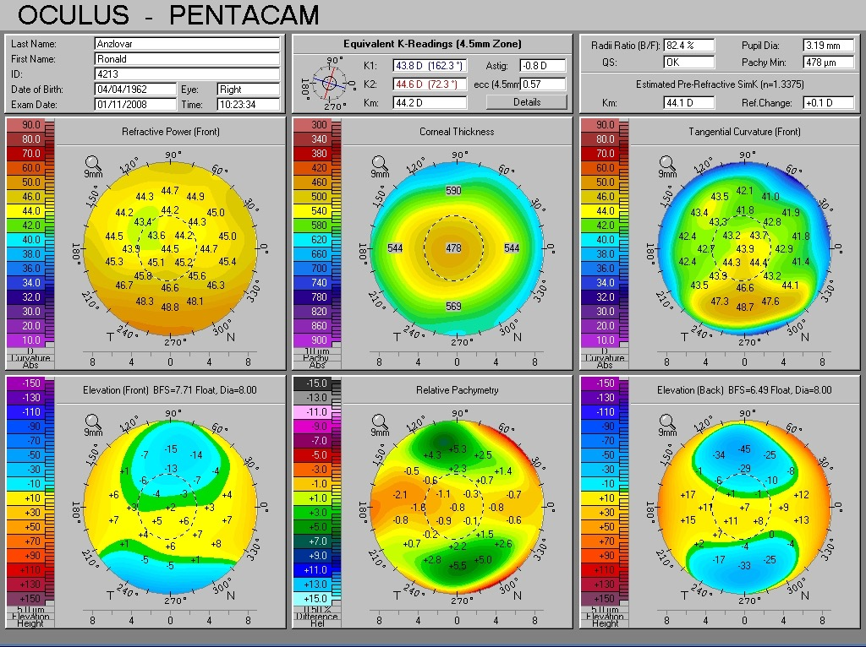
Elevation OD

Slide 8
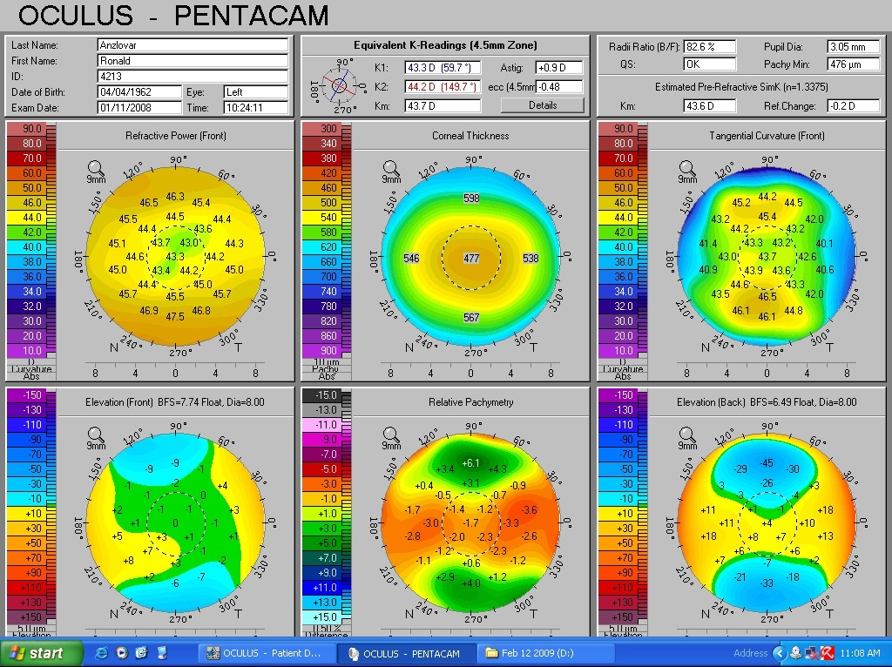
Elevation OS

Slide 9
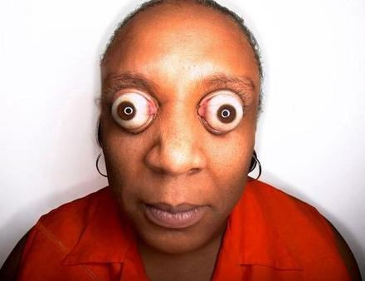
Case #1
Candidate?

Slide 10
Patient received ASA OU
Gentle w 20% ETOH
3 month post op:
OD plano 20/20
OS plano -.25 x 80 20/20

Slide 11
Case #2
31 yo female
OD -350-125x7 20/20
OS -150-100 x 155 20/20
Pachs 540/550
Normal health/eyes

Slide 12
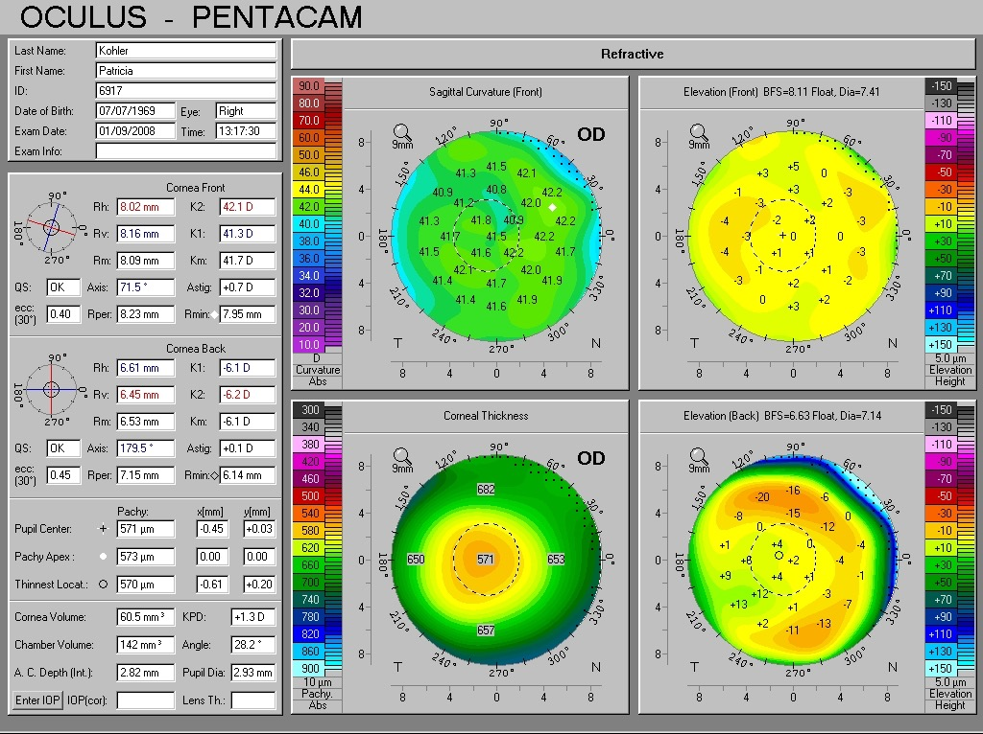
Elevation OD

Slide 13
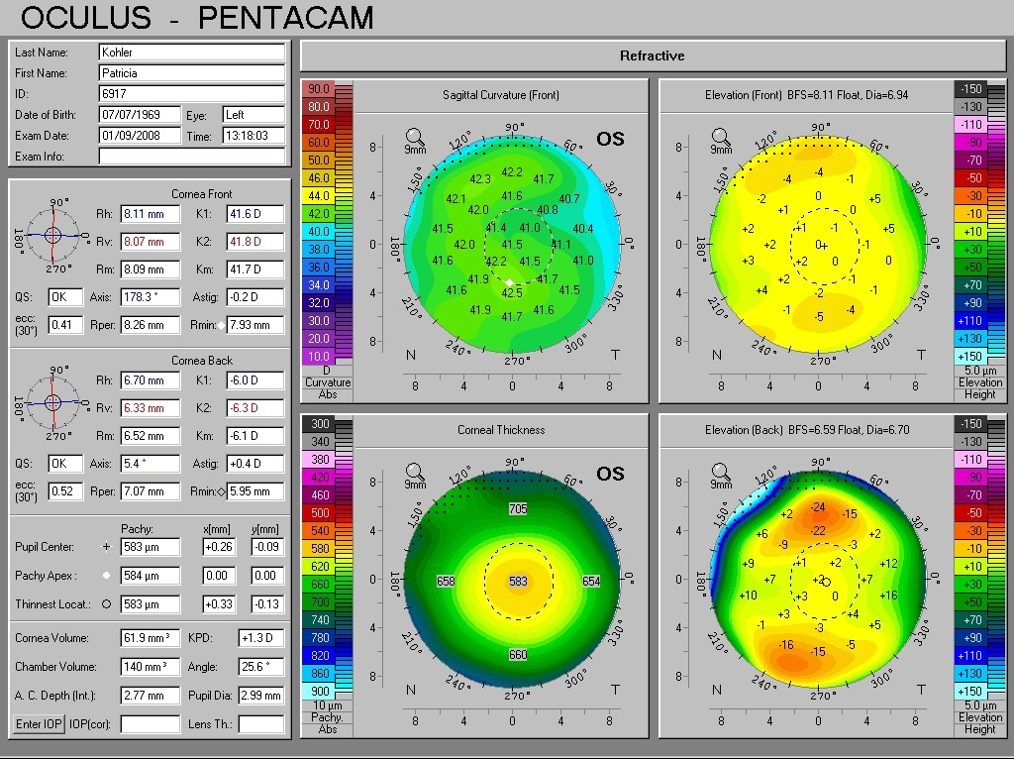
Elevation OS

Slide 14
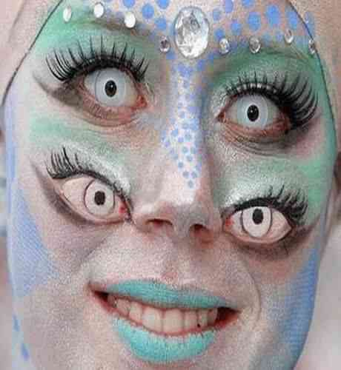
Case #2
Surgery? If so , what procedure?

Slide 15
Ideal LASIK Candidate
Correct age
Correct refraction
Good imaging
Healthy eyes
Reasonable expectations

Slide 16
Case #3
22yo male
OD -800-350 x 179 20/30+
OS -775 -125 x001 20/20
Pachs 540-550
Normal exam

Slide 17
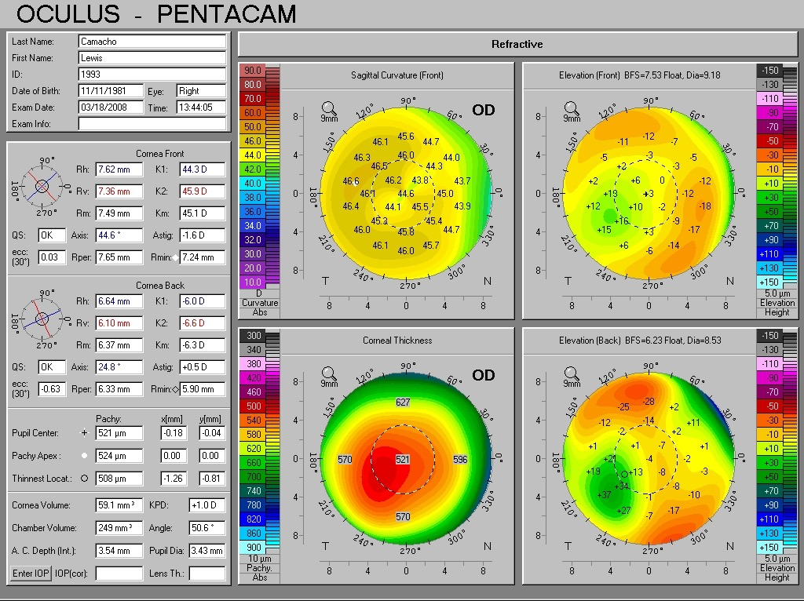
Elevation OD

Slide 18
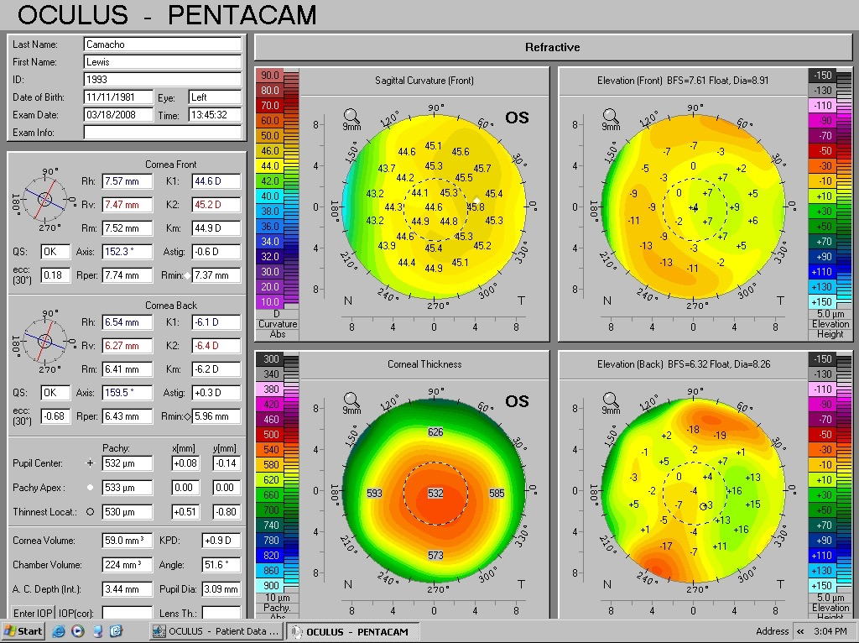
Elevation OS

Slide 19
Candidate??

Slide 20
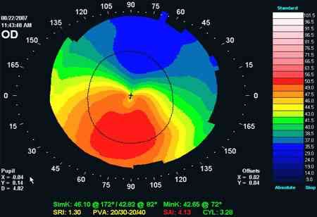
Topography

Slide 21
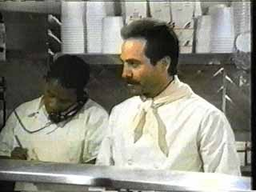
No Soup for You !!

Slide 22
Case #4
25yo FM
OD -6.00 sph 20/20
OS -6.50 sph 20/20
Pachs 535-547
Hx, pt notes herself, mother and sister all have “had problems with contact lenses”.

Slide 23
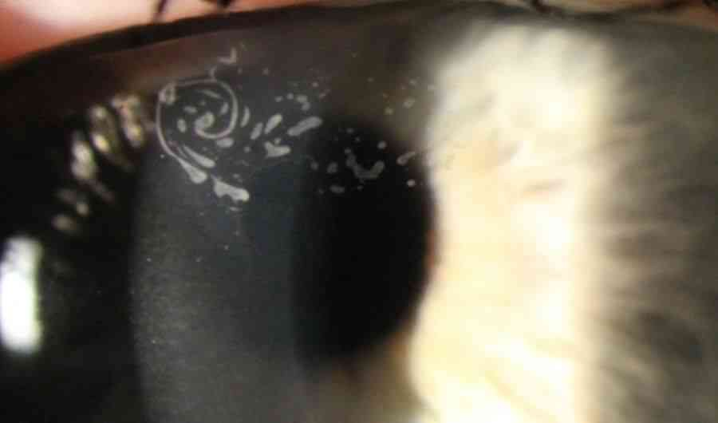
Slit lamp
Diagnosis?

Slide 24
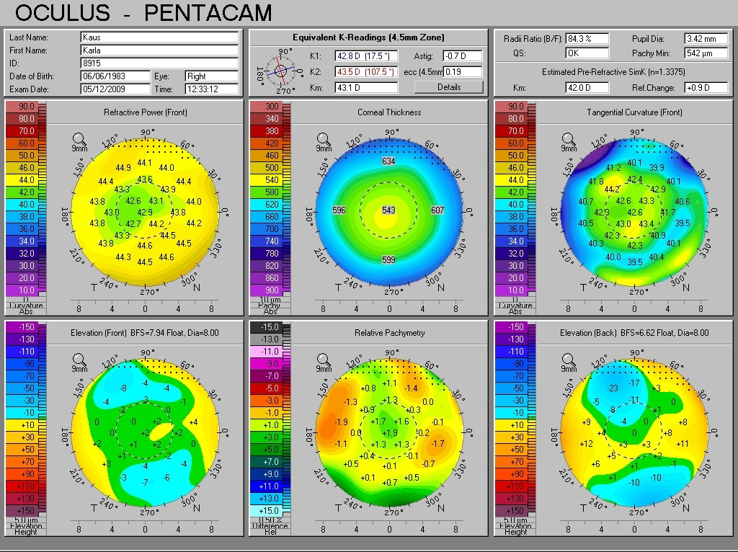
Elevation OD

Slide 25
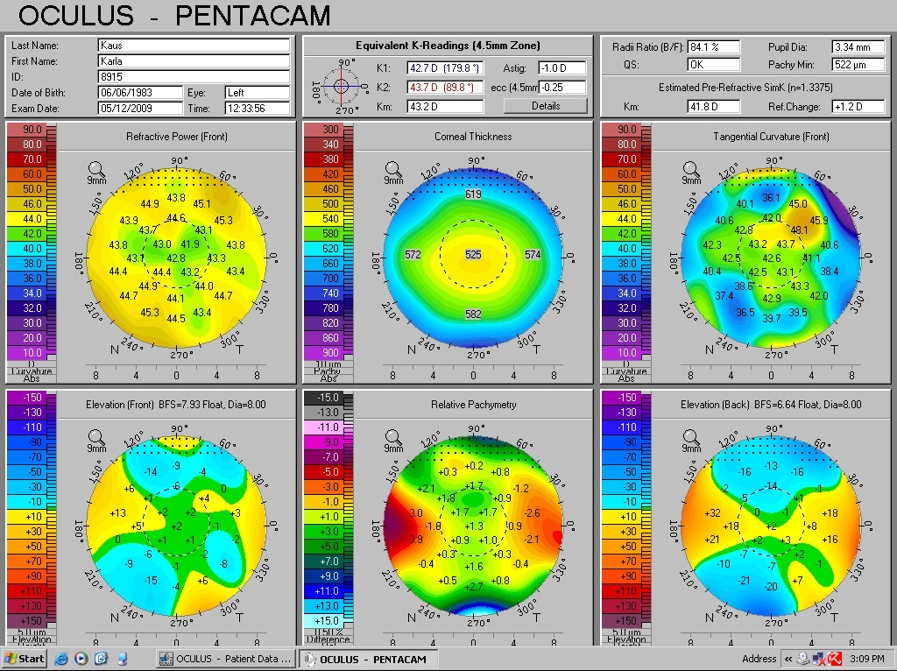
Elevation OS

Slide 26
Case #7
Candidate??

Slide 27
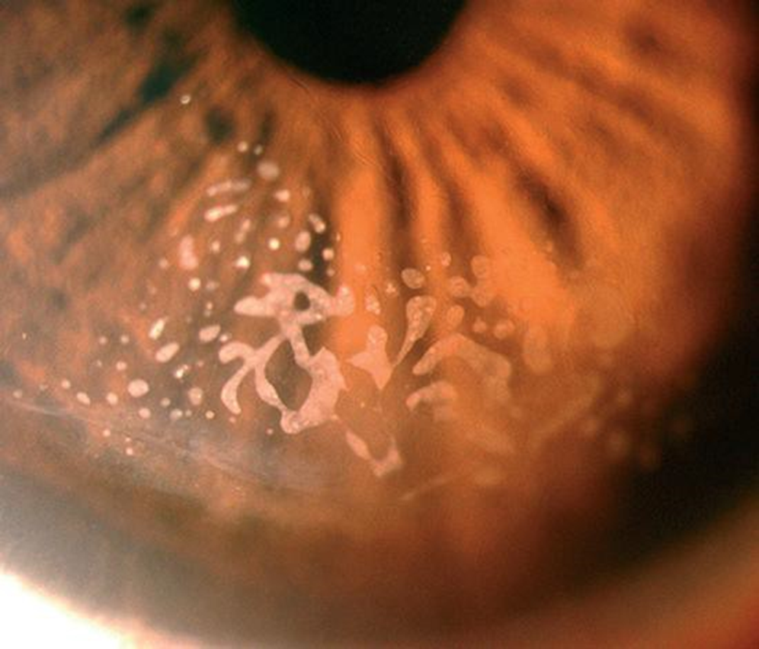
ASA
Refractive and therapeutic
Reduce risk of complications

Slide 28
Case #5
35 yo M
OD-575-.25x83 20/20
OS -575-.25x125 20/20
Pachs 559 OD 561 OS
Normal hx/SLE/fundus OU

Slide 29
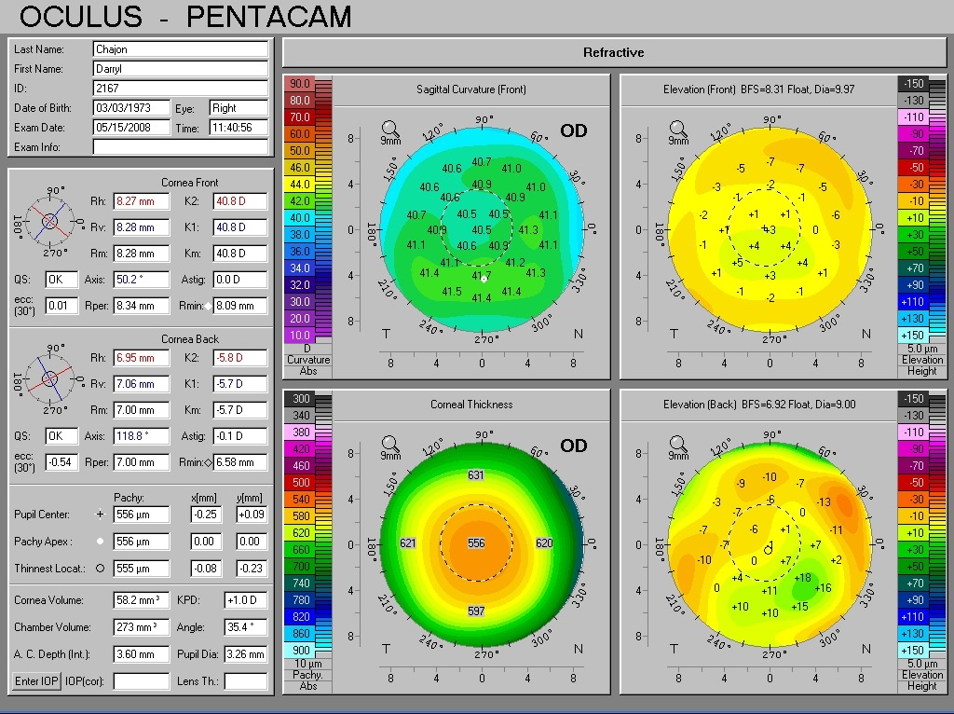
Pentacam OD
POST FLOAT

Slide 30
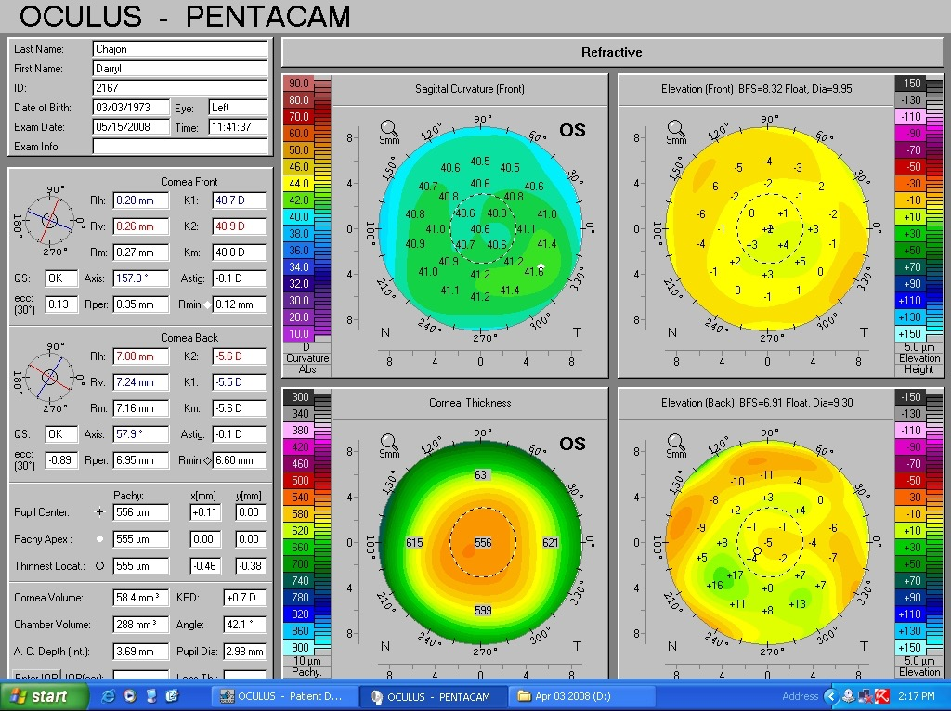
Pentacam OS

Slide 31
Candidate?

Slide 32
ASA with ectasia discussion
NO LASIK

Slide 33
Thank You

