Slide 1
EMERGING GLAUCOMA THERAPY
Marilynn Sultana, M.D., F.A.C.S.
Cataract and Eye Consultants of Michigan Warren, MI

Slide 2
Targeting IOP through Therapies with New Mechanisms of Action
Medical therapy
  Common first-line therapy
Selective Laser Trabeculoplasty (SLT)
Emerging therapies provide a novel approach to IOP management

Slide 3
Pathways for IOP Reduction
Uveoscleral pathway: PGA, Alpha-agonist (AA)
Aqueous suppression: Timolol, CAI, AA
Trabecular outflow: Emerging medications
  Latanoprostene bunod (LBN), Netarsudil, Trabodenoson
Episcleral venous pressure (EVP) reduction: Netarsudil

Slide 4
IOP Lowering Drugs:
Sites of Action
Decrease trabecular outflow resistance
  LBN (NO), Netarsudil (Rhopressa), Trabodenoson
Open angle by mechanical tension
  Miotics
Aqueous suppression
  Beta blockers, CAI, Alpha agonists, Netarsudil
Increase uveoscleral outflow
  Prostaglandins, Alpha agonists, LBN (PGA), Netarsudil

Slide 5
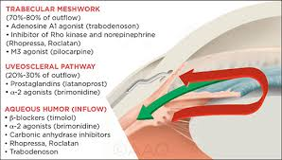
IOP Lowering Drugs:
Sites of Action

Slide 6
New Medications and
New Mechanisms
Latanoprostene bunod (Vyzulta)
  Nitric Oxide donating PGA
Netarsudil (Rhopressa)
  Rho kinase inhibitor
Trabodenoson
  Adenosine agonist

Slide 7
Latanoprostene Bunod 0.024%
(LBN)
Recently approved
Metabolizes into 2 active ingredients:
  Latanoprost
  Nitric oxide contributing component
Increases outflow by acting on uveoscleral pathway (Latanoprost) and TM and Schlemm’s (NO signaling)
Once daily dosing

Slide 8
Nitric Oxide (NO)
Intracellular signaling molecule produced endogenously by NO synthases
  Key role in vasodilation via action on smooth muscle
    Example: sublingual nitroglycerin for angina
NO activates cyclic GMP pathway, leads to relaxation of TM cells, increasing outflow through TM

Slide 9
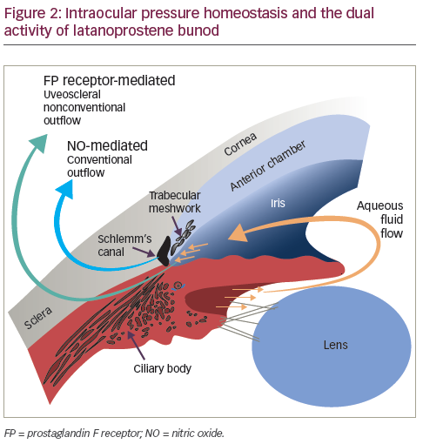
Latanoprostene Bunod (LBN)
LBN affects both aqueous outflow pathways
  Trabecular
    Conventional
  Uveoscleral
    Non-conventional

Slide 10
LBN: Mechanism of Action
Latanoprostene bunod = Latanoprost
  Increases uveoscleral outflow
Bunod donates NO
  Affects trabecular smooth muscle
  Activates cyclic guanosine monophosphate (cGMP) signaling pathway
  Result: trabecular relaxation and enhanced trabecular outflow

Slide 11
LBN 0.024%: Efficacy
More effective in reducing IOP than Latanoprost or Timolol
Voyager Study - compares LBN to Latanoprost
  Lower IOP by 1.0 – 1.5 mmHg
  Lower mean diurnal IOP
Lunar study – compares LBN to Timolol
  Significantly greater IOP lowering over 3 months
  Significantly lower mean diurnal IOP
Side effect profile similar to Latanoprost

Slide 12
Rho Kinase Inhibitor
Netarsudil 0.02% - generic
Rhopressa – brand name
aka ROCK/NET inhibitors
Hypotensive agent
  Rho kinase – increases trabecular outflow
  Norepinephrine transporter (NET) – reduces aqueous production

Slide 13
Rho Kinase (ROCK) Inhibitor
New development in IOP reduction
Rho kinase (ROCK) activation increases contractility of TM cells
  Results in formation of actin fibers and adhesions, increasing contractility and resistance
  Reduces outflow of aqueous through TM
ROCK inhibition relaxes TM cells
  Increases outflow of aqueous through TM
ROCK inhibition may also
  Increase ocular blood flow
  Increase retinal ganglion cell survival

Slide 14
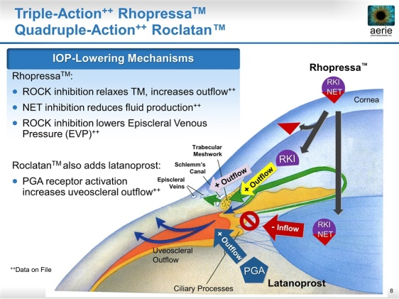

Slide 15
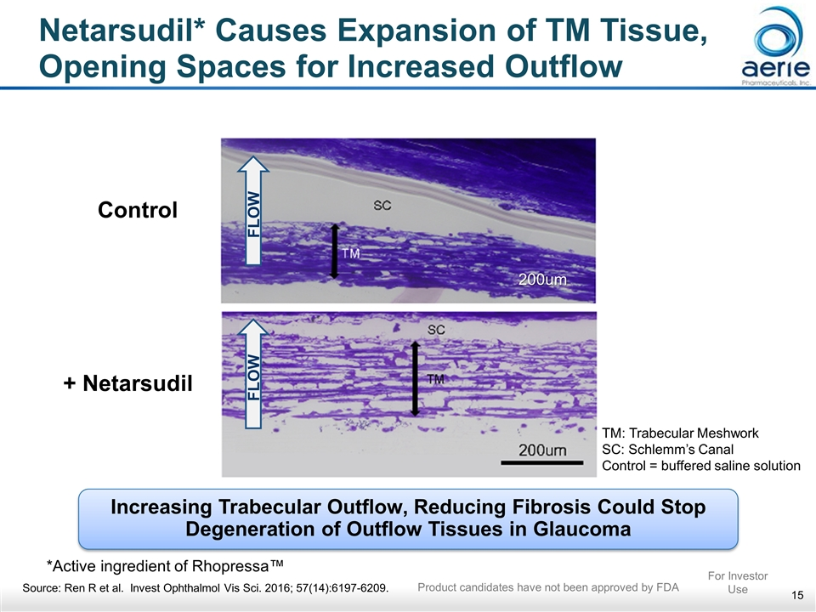

Slide 16
Netarsudil vs Latanoprost: IOP Bacharach Study
IOP mmHg
 | BASELINE | DAY 14 | DAY 28
Netarsudil 0.02% | 25.6 | 19.5 | 20.0
Latanoprost | 25.5 | 18.4 | 18.7

Slide 17
Trabodenoson
Mechanism of Action
Highly selective A1 receptor adenosine mimetic
Binds to A1 receptors in epithelial cells in TM
Upregulates matrix metalloproteinase- 2 (MMP-2)
Higher levels MMP-2 remodels extracellular matrix, restores outflow of aqueous through TM and lowers IOP

Slide 18
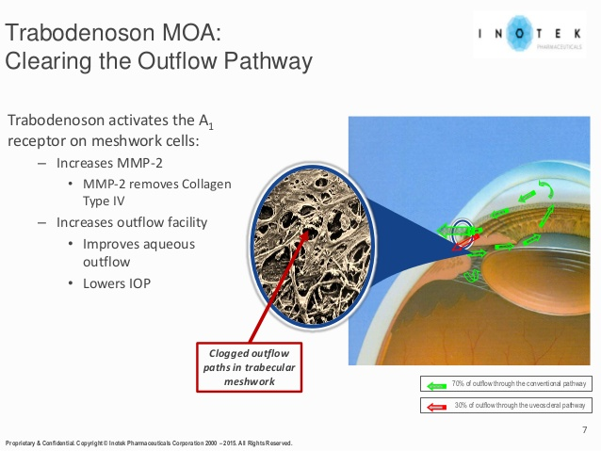

Slide 19
Established Combinations
Timolol 0.5% Brimonidine 0.2% | Timolol 0.5 % Dorzolamide 2.0% | Brinzolamide 1.0% Brimonidine 0.2%
26%-33% IOP reduction from baseline | 27%-32% IOP reduction from baseline | 21%-35% IOP reduction from baseline
Contraindicated for patients with asthma, COPD | Contraindicated for patients with asthma, COPD | Only US combo without beta blocker
 | Beware of sulfonamide sensitivity | Beware of sulfonamide sensitivity

Slide 20
Roclatan
Netarsudil 0.02%/ Latanoprost 0.005%
ROCK inhibitor Netarsudil /Latanoprost
  In addition to PGA effects, increases aqueous outflow through TM and lowers EVP
In phase 3 trials
  Superior IOP lowering to individual components
  More hyperemia that Latanoprost alone
Once daily dosing

Slide 21
Trabodenoson/Latanoprost
Selective adenosine mimetic that increases aqueous outflow combined with proven PGA
Study comparing combo to Latanoprost alone
  At 28 days, 1X/day dose - IOP improved 1.2 mmHg
  At 56 days, 2X/day dose - no meaningful clinical advantage

Slide 22
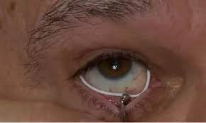
All in the Delivery
In clinical trials:
  Bimatoprost-eluting silicone-coated periocular ring

Slide 23
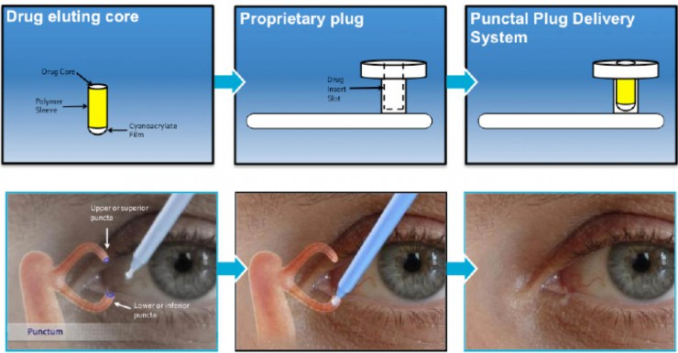
All in the Delivery
In clinical trials
Travoprost – delivering canalicular plugs
Latanoprost – delivering punctal plugs

Slide 24
Conclusions
New drugs with novel mechanisms of action will benefit patients
  Physiologic targeting – TM, EVP
Combination therapy with new drugs increases opportunity to hit IOP target quickly
New delivery systems may offer a sustained-release option

Slide 25

THANK YOU

