Slide 1
MANAGING HERPES SIMPLEX KERATITIS
Marilynn Sultana, M.D., F.A.C.S.
Cataract & Eye Consultants of Michigan
29753 Hoover Rd.
Warren, MI 48093

Slide 2
Learning Objectives
Describe clinical presentations of herpes simplex keratitis
Explain available therapies

Slide 3
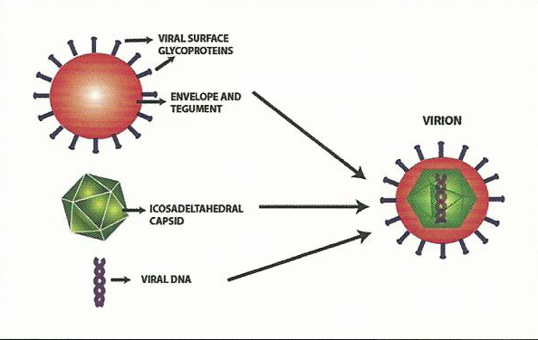
Structure of Herpes Simplex Virus
Herpes simplex virus types I and 2 (HSV-1, HSV-2)
Double-stranded DNA
Viral-derived capsid
Host-cell derived envelope
Glycoprotein projections

Slide 4
Epidemiology of Ocular HSV
Initial exposure: childhood “viral” illness
Ocular manifestation: reactivation of latent virus
Blepharitis, follicular conjunctivitis, keratitis, keratouveitis, acute retinal necrosis
50,000 new and recurring cases annually
Recurrence rate: 27% at one year

Slide 5
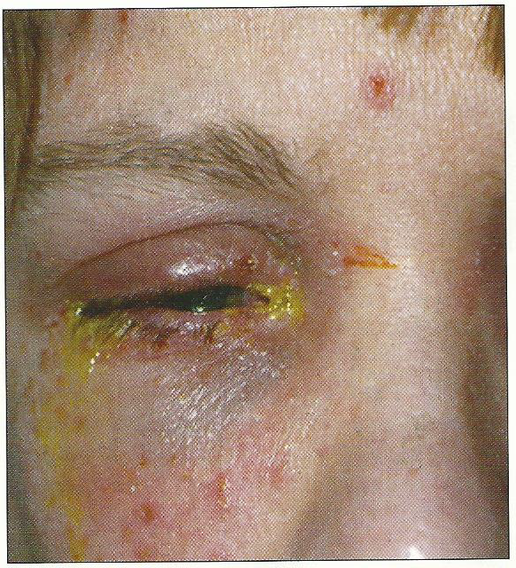
Primary HSV Ocular Infection
Less common presentation
Pediatric age
Fever, malaise
Skin rash
Unilateral follicular conjunctivitis – suspect HSV

Slide 6
Life Cycle of Herpes Simplex Virus

Slide 7
Recurrent HSV Infection
Orofacial: Cold sores on lip, cheek or tongue
Ocular: Most frequently involves cornea
Epithelial keratitis – active virus
Stromal keratitis – immunologic

Slide 8
HSV Keratitis Classification
HSV CATEGORY | COMMON NOMENCLATURE | TREATMENT
Epithelial Keratitis | Dendritic Keratitis Geographic Keratitis | Antiviral (topical or oral) or debridement
Stromal Keratitis without ulceration | Interstitial Keratitis Immune Stromal Keratitis | Topical steroid + oral antiviral prophylaxis
Stromal Keratitis with ulceration | Necrotizing Keratitis | Oral antiviral in therapeutic doses + topical steroid
Endothelial Keratitis | Disciform Keratitis | Oral antiviral in therapeutic doses + topical steroid

Slide 9
Epithelial Keratitis
Dendritic ulcer
Geographic ulcer
Others:
Marginal ulcer
Metaherpetic (trophic) ulcer

Slide 10
Epithelial Keratitis: Dendritic Ulcer
Classic corneal lesion
Branching with terminal bulbs
Raised borders
Consist of HSV-infected cells
Dendritic scar (ghost dendrite) may remain

Slide 11
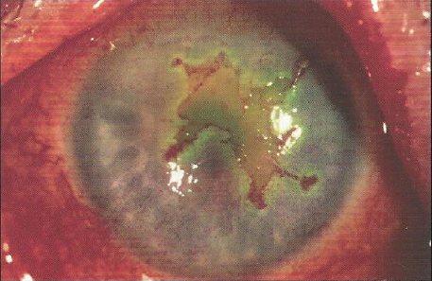
Epithelial Keratitis: Geographic Ulcer
Caused by replicating virus
Larger epithelial defect
Branching and terminal bulbs at periphery
Immunocompromised, on topical steroids, untreated dendrite

Slide 12
Epithelial Keratitis: Marginal Ulcer
Lesion near limbus
Resembles Staph ulcer
More stromal inflammation
More resistant to treatment

Slide 13
Epithelial Keratitis: Metaherpetic (Trophic) Ulcer
Epithelial ulceration
No live virus
“Trophic”: de novo
“Metaherpetic”: follows dendritic or geographic ulcer
Inability of epithelium to heal
Smooth borders
“Reverse staining”

Slide 14
Treatment: Metaherpetic Ulcer
Form of epithelial ulceration that does not have live virus
Goal: rapidly heal epithelial defect
Stop use of toxic meds
Punctal occlusion
Tear film supplements
Bandage contact lens
Tarsorrhaphy
Cautious use of topical steroids

Slide 15
Stromal Keratitis
Immune-mediated response to nonreplicating viral particles in stroma
Immune stromal keratitis
Interstitial keratitis
Necrotizing keratitis
Disciform keratitis (Endothelial keratitis)
Keratouveitis

Slide 16
Stromal: Immune Stromal Keratitis
Inflammatory response to viral antigen in stroma
Focal, multifocal, diffuse stromal opacities
Interstitial keratitis – vascularization
Ghost-like
HSV most common cause

Slide 17
Stromal: Necrotizing Keratitis
Reaction to live viral particles in stroma
History multiple recurrences
Corneal melting, perforation
Significant associated uveitis

Slide 18
Stromal: Disciform Keratitis (Endothelial Keratitis)
Endothelial dysfunction from inflammatory response to viral antigen
Disc-shaped area corneal edema
Minimal inflammation in stroma
Unilateral
Confused with Fuchs
bilateral

Slide 19
Stromal: Keratouveitis
Uveitis predominates
Mutton-fat KP
Immune-mediated
Unilateral uveitis with high IOP – suspect HSV

Slide 20
Diagnosis: HSV Keratitis
Clinical findings
Lab tests seldom needed
Of no use in stromal keratitis
Herpes Culture
HSV-1 or HSV-2 typing
Serum Antibody Testing
Positive titers in adults indicates past infection
Nearly universal

Slide 21
Diagnosis: Clinical Findings
Patient is in far less pain than findings would suggest
Photophobic or uveitis and high IOP
Patient has history of ocular HSV

Slide 22
Diagnosis: Reduced Corneal Sensation
Hallmark of HSK
Viral replication kills host neuron
Leads to hyposensitivity, poor tear production, persistent epithelial defects
Test prior to topical anesthetic
Use dental floss or cotton wisp

Slide 23
Long-Term Complications
Recurrent disease
Increased inflammation, scarring, decreased corneal sensation
Risk of stromal disease increases with recurrences of HSV epithelial keratitis
Recurrent episode occurs adjacent to site of previous episode

Slide 24
Treatment Fundamentals
HSV epithelial keratitis (live virus)
Topical or oral antivirals
No steroids
HSV stromal disease (little, if any, virus)
Topical steroids
Oral (never topical) antivirals as prophylaxis

Slide 25
Managing HSV Epithelial Keratitis
Debridement
Removes infected cells
Faster resolution, less scarring
Topical antiviral
Viroptic (Trifluridine)
Zirgan (Ganciclovir gel)
Oral antiviral
Zovirax (Acyclovir)
Valtrex (Valacyclovir)
Famvir (Famciclovir)

Slide 26
Topical Antivirals for HSV Epithelial Keratitis
 | Viroptic | Zirgan
 | Trifluridine solution 1% | Ganciclovir gel 0.15%
Dosage | 1 drop every 2 hours (daily dose: 9) until ulcer heals, then 5 times daily for 7 days | 1 drop every 3 hours (daily dose: 5) until ulcer heals, then 3 times daily for 7 days
Refrigeration | Refrigerate | Room temp
Preservative | Thimerosol 0.001% | BAK

Slide 27
Managing HSV Stromal Keratitis
Topical steroids
Simultaneous oral antiviral prophylaxis
Reduces risk of HSV reactivation at the trigeminal ganglion level
Zovirax
Valtrex
Famvir

Slide 28
Oral Antiviral Agents for HSV Keratitis
Agent | Treatment Dose | Prophylactic Dose
Zovirax (Acyclovir) | 400 mg five times daily | 400 mg twice daily
Valtrex (Valacyclovir) | 500 mg three times daily | 500 mg once daily
Famvir (Famciclovir) | 250 mg three times daily | 250 mg once daily

Slide 29
Using Steroids Correctly
Not used in acute epithelial keratitis
Essential for stromal keratitis
Prednisolone acetate 1% QID
S-l-o-w-l-y taper

Slide 30
Using Antiviral Prophylaxis Correctly
Oral antivirals
Primarily against reactivation at ganglion level
During topical steroid treatment for stromal disease
Patients with multiple recurrences (2 or more / year)
Keratitis close to visual axis
Immunocompromised patients
Long-term use for 1 year or more reduced risk of recurrent HSV

Slide 31
Quiz Time
No Cheating!

Slide 32
Case 1
42 year old female complains of red, irritated OD
SLE: single dendrite
Dx: first episode of HSV epithelial keratitis
Options:
Viroptic drops 9x/day for 1 week, then taper
Zovirax 400 mg 5x/day for 1 or 2 weeks
Both regimens combined

Slide 33
Case 1: Recommendation
Each approach reasonable
Consider full dose Viroptic drops
9x/day until ulcer heals
then 5x/day for 1 week
then stop

Slide 34
Case 2
51 year old male complains of irritated OS and mild photophobia, vision good
History of three previous episodes HSV epithelial keratitis
SLE: minimal scarring with adjacent new dendrite
Dx: recurrent HSV epithelial keratitis
Options:
Viroptic drops
Zovirax oral
Combination therapy

Slide 35
Case 2: Recommendation
Combination therapy
Viroptic 9x/day until ulcer heals, then 5x/day for 1 week
Full therapeutic dose Zovirax 400 mg 5x/day
Discontinue topical Viroptic within 2 weeks
Taper Zovirax to 400 mg BID for long-term prophylaxis (1 year)

Slide 36
Case 3
46 year old female complains of blurry vision OS.
History of treated herpetic dendrite 1½ years ago
Vision: 20/40
SLE: Mild stromal edema, no scarring
Dx: First episode of HSV stromal keratitis
Options:
Viroptic drops
Steroid drops
Zovirax oral
Combination therapy

Slide 37
Case 3: Recommendation
Combination therapy of topical steroids with oral antiviral coverage
Pred Forte QID and taper as necessary
Zovirax 400 mg BID until inflammation subsides

Slide 38
Case 4
62 year old male complains of blurry vision OD
History of two previous episodes of stromal keratitis
Vision 20/50
SLE: Mild to moderate edema and patchy scarring
Dx: Recurrent HSV stromal keratitis
Options:
Viroptic drops
Steroid drops
Zovirax oral
Combination therapy

Slide 39
Case 4: Recommendation
Combination therapy
Pred Forte 1% QID
Zovirax 400mg BID
Taper steroids s-l-o-w-l-y to avoid recurrence
Continue Zovirax long-term (1 year)

Slide 40
Congratulations!

Slide 41
THANK YOU

