Slide 1
Dry AMD Update
Randee Miller Watson, MD
Retina Consultants of Michigan

Slide 2
Financial Disclosures
I have no relevant financial disclosures

Slide 3
Overview
Review definitions
AMD
Drusen size and type
Disease classification
AREDS and AREDS2 studies
Calculating risk of progression
Treatment and future research

Slide 4
What is AMD
Leading cause of irreversible vision loss in US among persons > 65 years
At least age 50 years
Theorized: oxidative stress, chronic inflammation, predisposing genetic and environmental factors

Slide 5
Hallmark of AMD = yellow subretinal deposits ➔drusen
Often accompanied by hypo or hyperpigmentary changes of the retinal pigment epithelium (RPE)

Slide 6
Two forms:
Non-neovascular (Dry): 80-90%
Neovascular (Wet): 10-20%
Occurs when abnormal blood vessels develop in the sub-RPE or subretinal space

Slide 7
Risk factors for AMD
Increasing age
Smoking
Hypertension
Female sex
Caucasian race
Hyperopia
Positive family history

Slide 8
Categorizing Dry AMD
Drusen size
Type of drusen
Presence of pigmentary changes
Geographic atrophy
Neovascularization

Slide 9
Drusen Size
Small: <64μm in diameter
Intermediate: 64-124μm in diameter
Large: 125μm in diameter
Width of a large retinal vein at disc margin

Slide 10
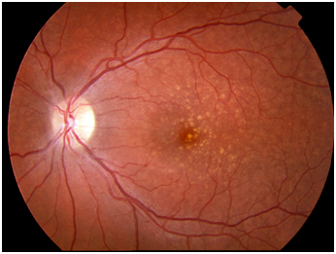
Type of Drusen
Hard: discrete and well demarcated

Slide 11
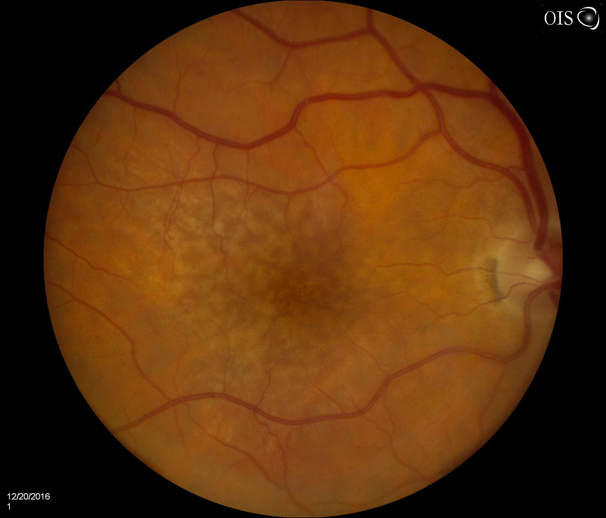
Type of Drusen
Hard: discrete and well demarcated
Soft: amorphous and poorly demarcated

Slide 12
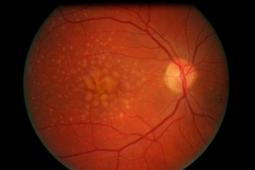
Type of Drusen
Hard: discrete and well demarcated
Soft: amorphous and poorly demarcated
Confluent: contiguous boundaries between drusen

Slide 13
Grading AMD Severity
Group 1: no AMD
No drusen or
Only a few (~5–15) small hard drusen

Slide 14
Grading AMD Severity
Group 2: early stage AMD
Extensive (>15) small hard drusen
Few (<20) medium-size soft drusen
Pigment abnormalities

Slide 15
Grading AMD Severity
Group 3: intermediate stage AMD
Presence ≥ 1 large druse
Numerous medium-size soft drusen (>20)
Noncentral geographic atrophy (GA)
Loss of RPE, choriocapillaris, overlying photoreceptors

Slide 16
Grading AMD Severity
Group 4: advanced AMD
Central geographic atrophy
Neovascular AMD

Slide 17
Neovascular AMD
Defined as pathologic angiogenesis originating from the choroidal vasculature that extends through a defect in Bruch’s membrane
Serous and/or hemorrhagic detachment of the neurosensory retina or RPE
Retinal hard exudates (a secondary phenomenon resulting from chronic intravascular leakage)
Subretinal and sub-RPE fibrovascular proliferation
Disciform scar (subretinal fibrosis)
Treatment: anti-vascular endothelial growth factor (anti-VEGF)

Slide 18
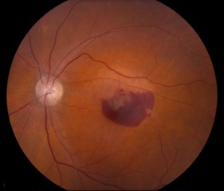
No AMD
Early AMD
Intermediate AMD
Advanced AMD

Slide 19
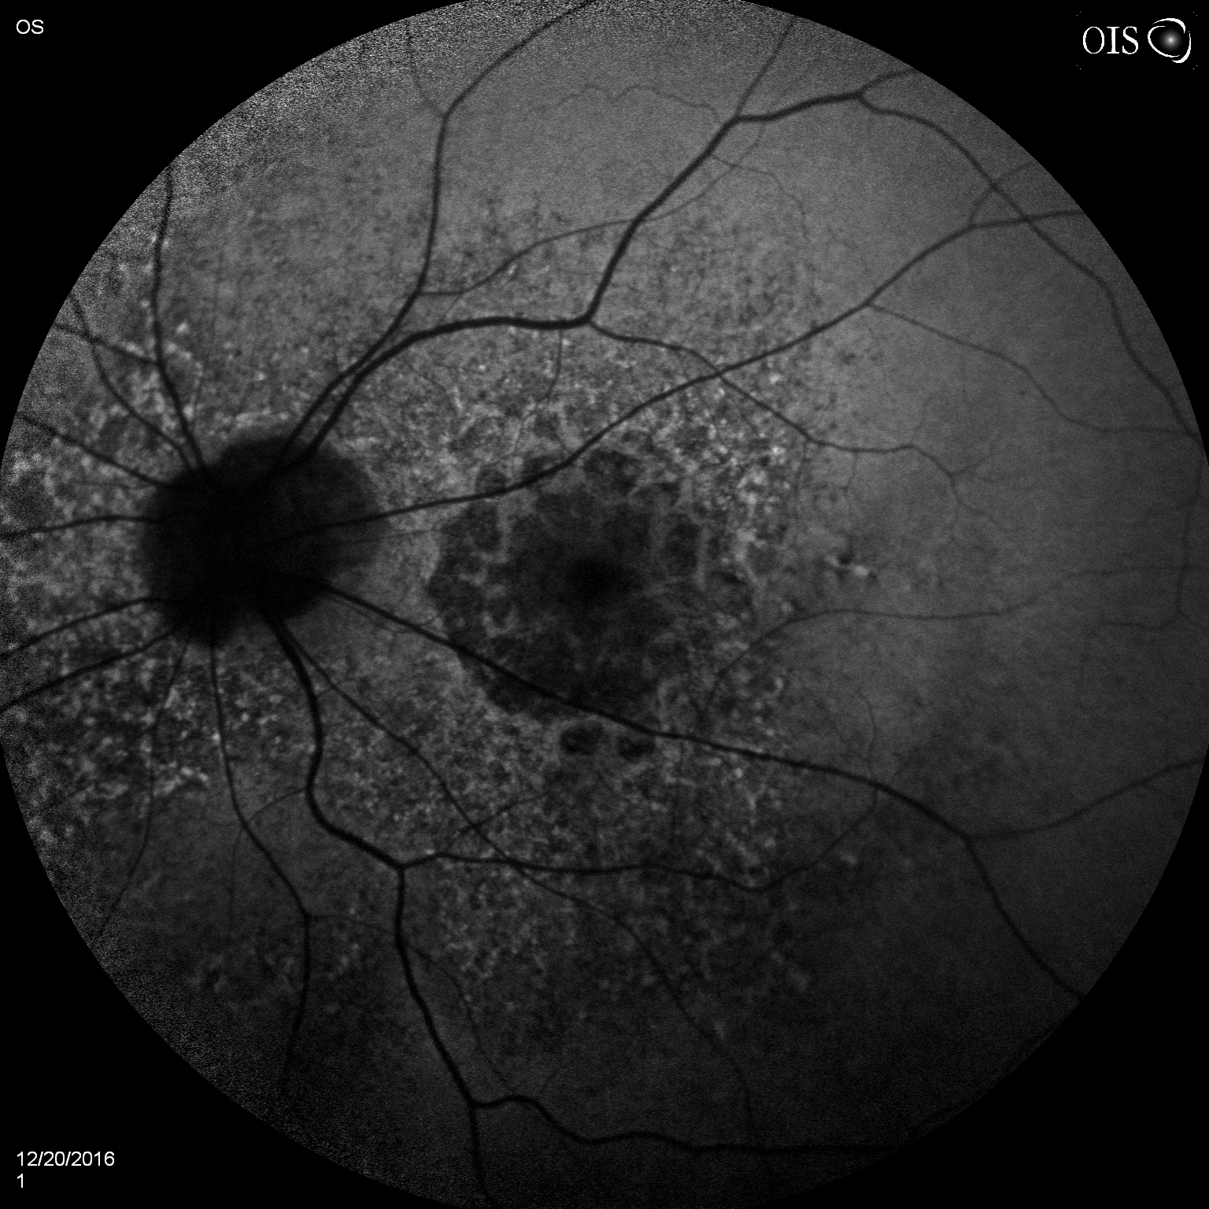
Advanced AMD

Slide 20
Outer retinal atrophy (loss of RPE, IS/OS, outer nuclear layer)

Slide 21
Outer retinal tubulation
Central GA (outer retinal atrophy, loss of RPE and IS/OS)
Increased signal penetration into choroid through area of GA

Slide 22
Treatment of Dry AMD
Two landmark large scale clinical trials
AREDS
AREDS2
Future areas of research

Slide 23
Age-Related Eye Disease Study (AREDS)
Multiple studies, 11 centers; 2001
Randomized, double-masked clinical trial for treatment with antioxidants and zinc
Case-control study to evaluate risk factors
Natural history data
Over 4,700 study participants
Ages 55–80 years

Slide 24
Age-Related Eye Disease Study (AREDS)
Inclusion criteria:
Extensive small drusen
Intermediate or large drusen
Noncentral geographic atrophy or pigment abnormalities in 1 or both eyes
Advanced AMD or vision loss due to AMD in 1 eye
At least 1 eye with BCVA 20/32 or better

Slide 25
Age-Related Eye Disease Study (AREDS)
Study design:
participants randomly assigned to 1 of 4 groups to receive daily oral tablets containing:
Group 1: antioxidants (vitamin C, 500 mg; vitamin E, 400 IU; and beta carotene, 15 mg)
Group 2: zinc 80 mg (as zinc oxide) and copper, 2 mg (as cupric oxide)
Group 3: antioxidants plus zinc
Group 4: placebo

Slide 26
Age-Related Eye Disease Study (AREDS)
Results:
Antioxidants + zinc (Group 3)
statistically significant reduction in risk of developing advanced AMD and vision loss from AMD
For eyes with intermediate or advanced AMD

Slide 27
Age-Related Eye Disease Study 2 (AREDS2)
Over 4,200 participants, 82 centers; 2012
Ages 50-85 years
Purpose:
To evaluate the efficacy and safety of lutein + zeaxanthin (L+Z) and/or omega-3 fatty acids in reducing the risk of developing advanced AMD
To assess the reduction in zinc and the omission of beta-carotene from original AREDS formulation

Slide 28
Age-Related Eye Disease Study 2 (AREDS2)
Inclusion criteria:
Bilateral large drusen or
Large drusen in one eye and advanced AMD (neovascular AMD or central geographic atrophy) in the fellow eye
Results:
No change in rate of AMD progression with replacement of beta-carotene by lutein or zeaxanthin compared to original AREDS
No effect of omega 3 fatty acids

Slide 29
Vitamin Formulas
AREDS
Vitamin C 500mg
Vitamin E 400 IU
Zinc oxide 80mg
Cupric oxide 2mg
Beta-carotene 15mg
Smokers formula
No vitamin A
AREDS2
Vitamin C 500mg
Vitamin E 400 IU
Zinc oxide 80mg
Cupric oxide 2mg
Lutein 10mg and
Zeaxanthin 2mg
Smokers formula not needed as no Vitamin A

Slide 30
Risk of Advanced AMD
Scoring system
1 point to each eye for:
At least 1 large druse
Any pigment abnormality (increased or decreased pigment, GA)
Intermediate drusen in BOTH eyes (but no large drusen in either)
Advanced AMD in worse eye: 2 points

Slide 31
Risk of Advanced AMD
Risk factors summed across both eyes
Range 0-4 possible points
5-year risk of developing advanced AMD in at least one eye can be approximated
0: 0.5%
1: 3%
2: 12%
3: 25%
4: 50%

Slide 32
Treatment and Monitoring
AREDS2 regimen (or AREDS for never-smokers)
For eyes with intermediate or advanced AMD
Counsel regarding 5-year risk of development of advanced AMD
Modifiable risk factors
Smoking cessation
Hypertension control
Home monitoring of monocular near vision
Amsler grid

Slide 33
Future Research
Recent research has linked complement system to the development of AMD
Particularly complement factor H (CFH) – up to 5x increase in risk of AMD
Many studies targeting complement system
Anti-complement factor D
Antibody to C5
Other targets
Antibody to β-amyloid
Subretinal injection of stem-cell derived RPE cells
RPE65 inhibitor: modulates visual cycle

Slide 34
References
Bressler SB, Bressler NM. Age-Related Macular Degeneration: Non-neovascular Early AMD, Intermediate AMD, and Geographic Atrophy. In: Ryan SJ, Schachat, Sadda SR, eds. Retina. 5th ed. Philadelphia: Elsevier/Mosby; 2013 :1150-82.
Basic and clinical science course (BCSC) Section 12: Retina and Vitreous. San Francisco, CA: American Academy of Ophthalmology; 2011:109-132.
Chakravarthy, U. “Classification of Age-related Macular Degeneration”. Retinal Physician. http://www.retinalphysician.com/issues/2012/october-2012/classification-of-age-related-macular-degeneration. 1 Oct 2012
Age-Related Eye Disease Study Research Group. A Randomized, Placebo-Controlled, Clinical Trial of High-Dose Supplementation With Vitamins C and E, Beta Carotene, and Zinc for Age-Related Macular Degeneration and Vision Loss: AREDS Report No. 8. Arch Ophthalmol 2001; 119(10): 1417–36.
Age-Related Eye Disease Study Research Group. A Simplified Severity Scale for Age-Related Macular Degeneration: AREDS Report No. 18. Arch Ophthalmol 2005; 123(11): 1570–74.
Chew EY, Clemons T, SanGiovanni JP, et al. The Age-Related Eye Disease Study 2 (AREDS2): Study Design and Baseline Characteristics (AREDS2 Report Number 1). Ophthalmology 2012; 119(11): 2282–89.
DeAngelis MM, Silveira AC, Carr EA, Kim IK. Genetics of Age-Related Macular Degeneration: Current Concepts, Future Directions. Semin Ophthalmol 2011; 26(3): 77–93.

