Slide 1
Retinal OCT Review
Randee Miller Watson, MD
Retina Consultants of Michigan

Slide 2
Financial Disclosures
I have no relevant financial disclosures

Slide 3
A little about myself…

Slide 4
Outline
What is OCT: overview of technology
Indications for macular OCT
OCT interpretation and practical examples
The future of OCT

Slide 5
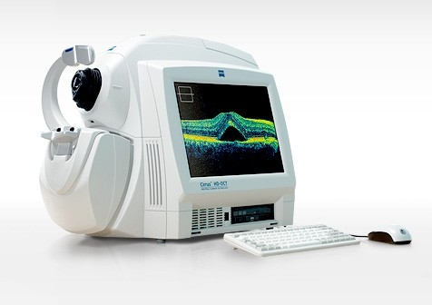
What is OCT
Optical Coherence Tomography

Slide 6
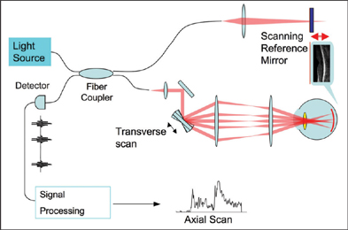
Time Domain OCT
Older, original OCT technology
400 A-scans/second
Resolution limited 10-15μm

Slide 7
Spectral Domain OCT
Newer, now standard OCT technology
20,000-40,000 A-scans/second
Resolution up to 3-5μm

Slide 8
Time Domain vs Spectral Domain

Slide 9
Advantages
Rapid image acquisition
Dilation typically not required
Limitations
Media clarity
Dry eyes, corneal opacity, cataract, vitreous hemorrhage, etc
Poor fixation
Positioning

Slide 10
When to get OCT?
To aid in diagnosis/better visualize retinal layers
Abnormality seen on fundus exam
Drusen, diabetes, vein occlusion, atrophy, scar, edema
Poor VA without identifiable pathology
Monitor disease progression/change
Monitor response to treatment

Slide 11
How to use OCT
Interpreting OCT reports
Describing OCT images

Slide 12
Macular OCT Printed Reports
ETDRS grid with thickness measurements displayed in each macular sector and color-coded topographical map of current scan
Infrared fundus image with color-coded topographical overlay with ETDRS grid that allows for comparison to normative data
Important: the EDTRS grid overlay is movable and may be inaccurate if not properly centered
ETDRS grid with thickness measurements and color-coded topographical map of reference scan
ETDRS grid and color-coded topographical map displaying change in thickness compared to reference scan
Horizontal line scan overlaying infrared fundus image
Corresponding macular thickness B-scan
Color-coded graph displaying change in thickness compared to reference scan

Slide 13
Macular OCT Printed Reports
ETDRS grid with thickness measurements displayed in each macular sector
Infrared fundus image with color-coded topographical overlay that allows for comparison to normative data
Magnified image of fovea
3D surface maps of ILM-RPE
Horizontal central line scan
Vertical central line scan
Color-coded summary of central subfield thickness, cube volume, and average cube thickness compared to normative data
Compares thickness to normative data

Slide 14
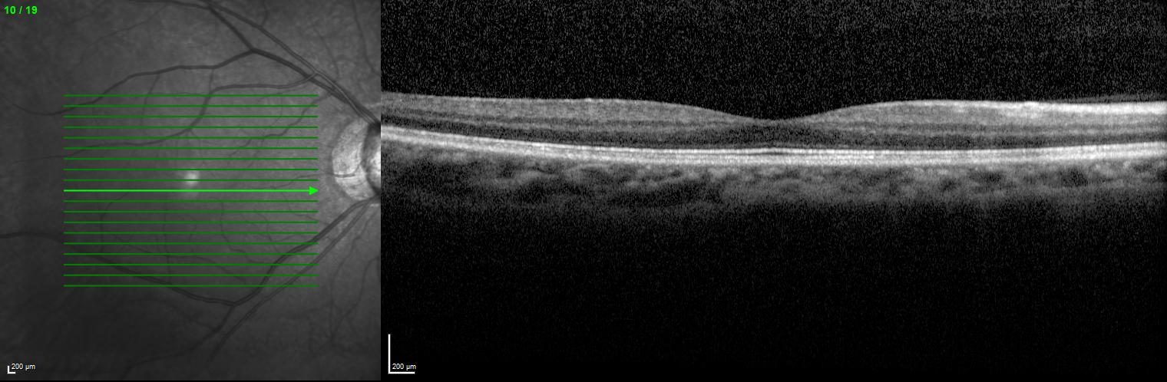
Normal OCT
Normal CST: 250-300μm

Slide 15
Words to Describe OCT
Location
Subretinal
Intraretinal
Preretinal
Appearance
Hyperreflective
Hyporeflective
Disruption
Attenuation
Atrophy
Elevation

Slide 16
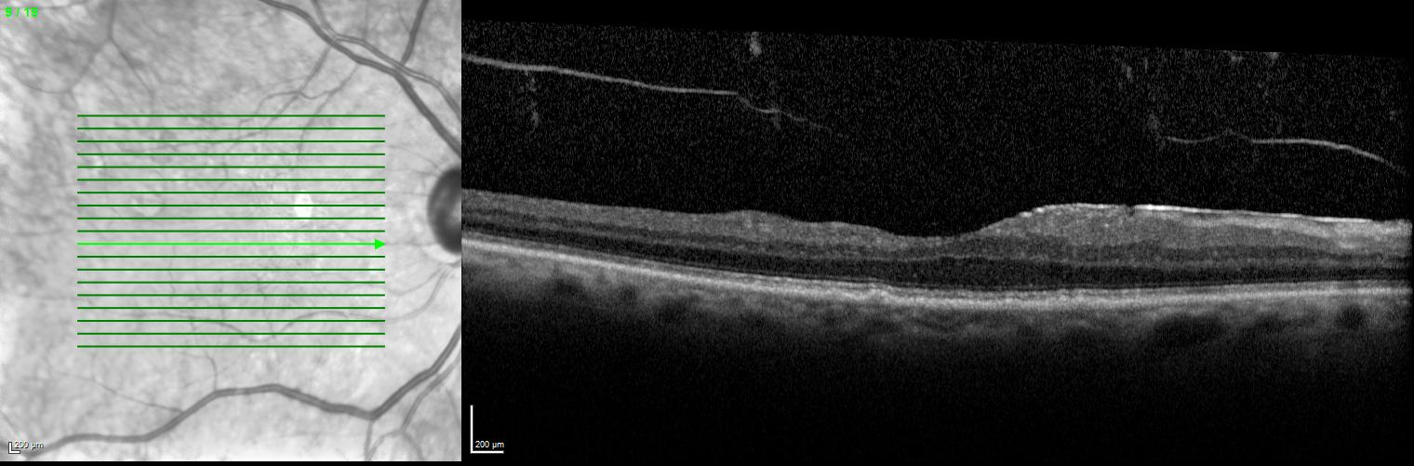
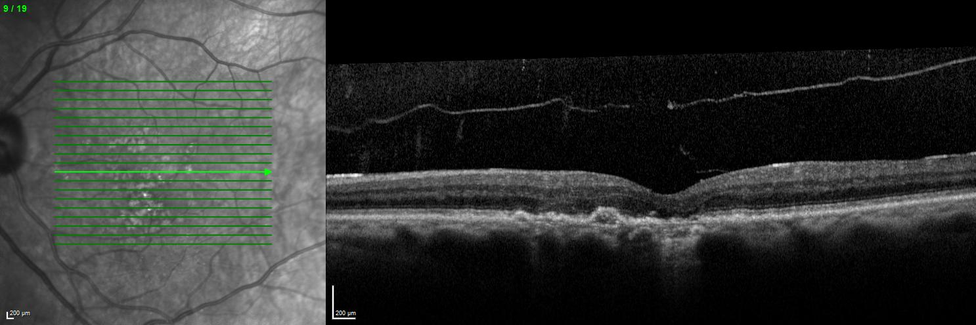
Real Life Examples
Epiretinal membrane (ERM)
Diagnosis?
80 y/o M, VA 20/30 OU
Dry AMD OU ERM OD>OS
Drusen

Slide 17
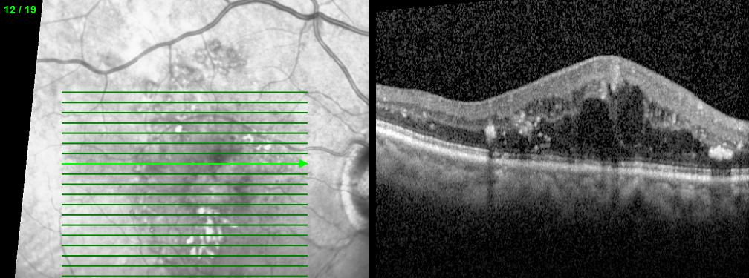
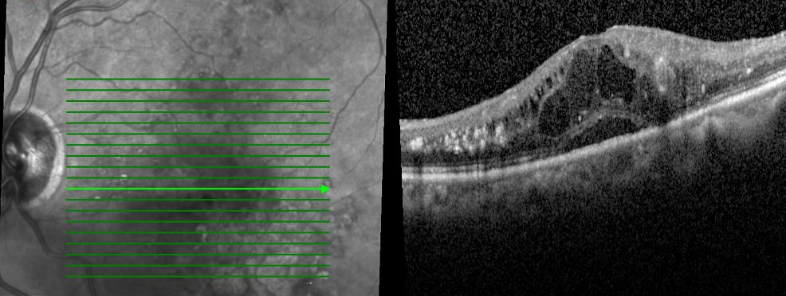
Hard exudate
Diagnosis?
55 y/o F
VA 20/60 OD, 20/80 OS
DME OU
Intraretinal fluid
Hard exudate
Subretinal fluid

Slide 18
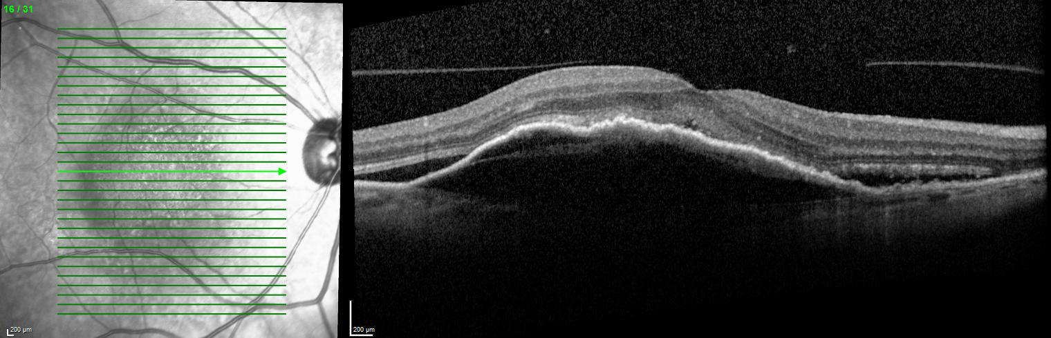
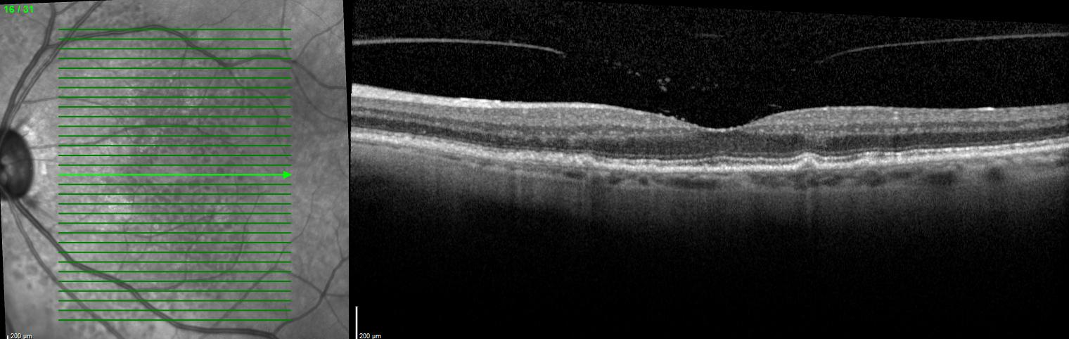
Large serous pigment epithelial detachment (PED)
Diagnosis?
74 y/o F
VA 20/60 OD, 20/30 OS
OD: Neovascular AMD with SRF and PED
OS: Dry AMD
Subretinal fluid
Drusen

Slide 19
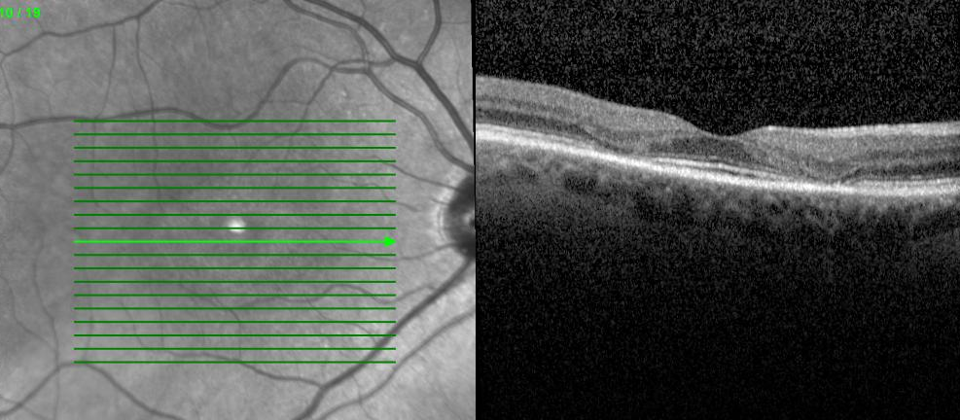
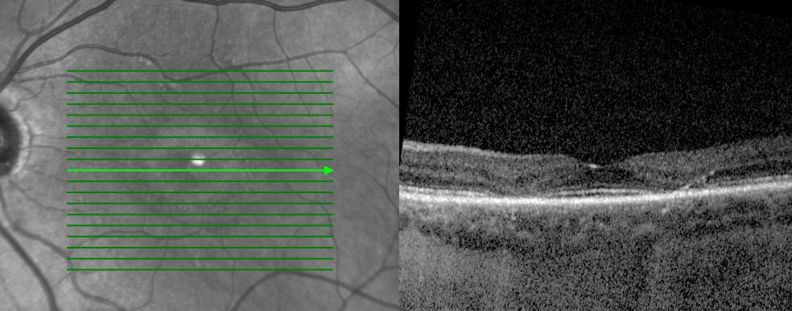
Diagnosis?
53 y/o F on plaquenil for 1° Sjogren syndrome
VA 20/20 OU
Plaquenil toxicity OU
Parafoveal loss of IS/OS and ELM

Slide 20
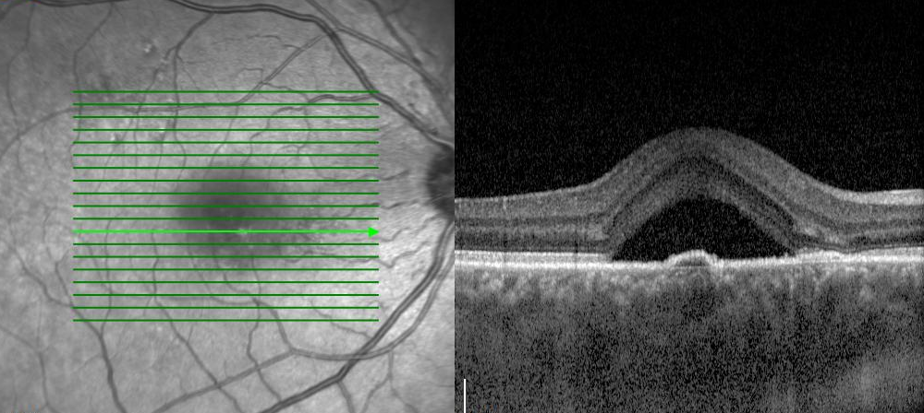
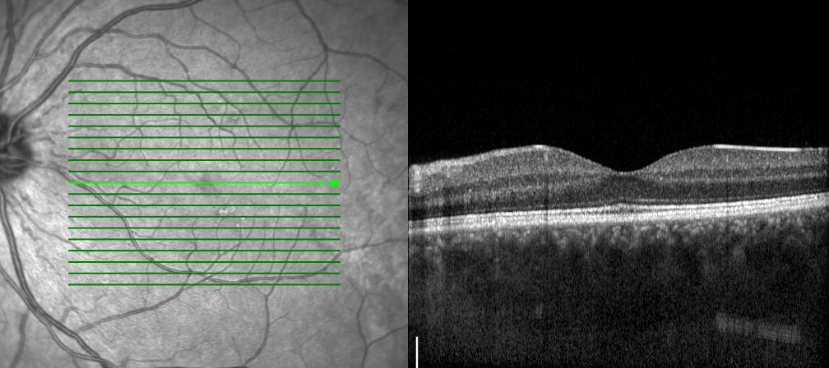
Subretinal fluid
PED
Diagnosis?
39 y/o M police officer
“Circle in vision” OD x 1 week
VA 20/25 OU
Central serous retinopathy
Normal OS?
Thickened choroid OU

Slide 21
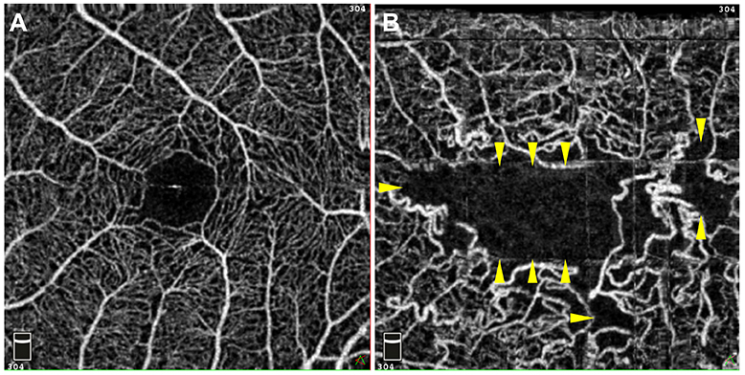
Future of OCT
OCT angiography

Slide 22
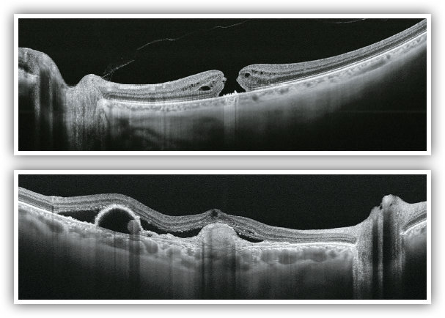
Future of OCT
OCT angiography
Swept-source OCT

Slide 23
References
Grover S, Murthy RK, Brar VS, Chalam KV. Normative data for macular thickness by high-definition spectral-domain optical coherence tomography (spectralis). Am J Ophthalmol. 2009;148(2):266-71.
Mazzarella J, Cole J. “The Anatomy of an OCT Scan”. Review of Optometry. https://www.reviewofoptometry.com/article/the-anatomy-of-an-oct-scan. 15 Sep 2015.
Reichel E, Ho J, Duker JS. “OCT Units: Which One Is Right for Me?” Review of Ophthalmology. https://www.reviewofophthalmology.com/article/oct-units-which-one-is-right-for-me. 23 Sep 2009.
Sepah Y, Agarwal A, and Nguyen QD. “OCT Angiography eUpdate”. Retinal Physician. http://www.retinalphysician.com/newsletter/oct-angiography-eupdate/december-2015. Dec 2015.

